Slide 1
WILLIAM HENNING, N.D.,Opt.D.
THE
PRACTICE OF
MODERN OPTOMETRY
1939
Notes:
He wrote other books:
The Fundamentals of Chrome-Orthoptics(1940) and
Procedures in Refraction and Functional Disorders of Vision (1940)

Slide 3
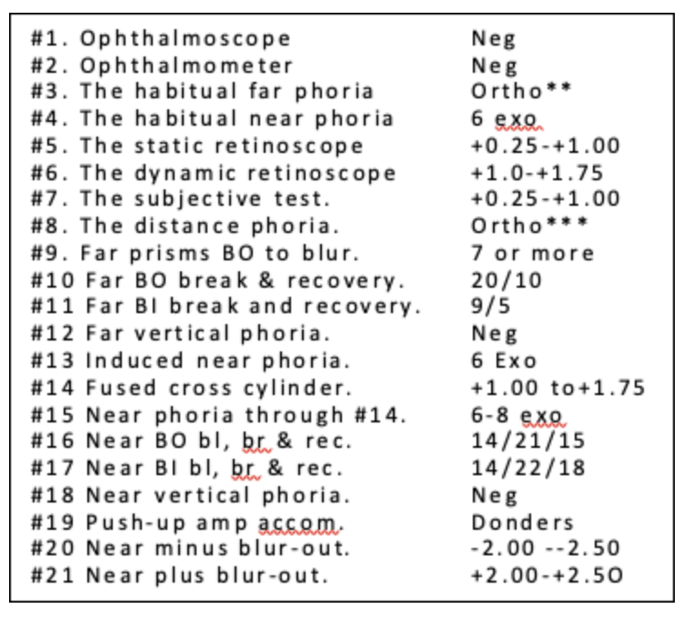
OEP 21 Points Expected

Slide 4
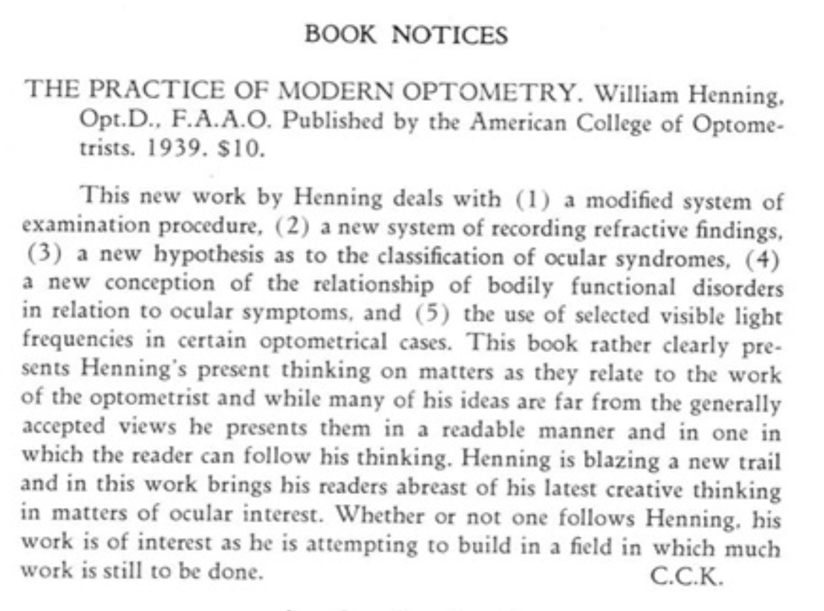

Slide 5
Henning was a Contemporary of H. Riley Spitler
Both worked with Carl Loeb, M.D. to develop his system of phototherapy, described in Loeb’s book: A Course in Specific Light Therapy (1931, 1939 6th addition).
Henning, O.D., N.D. and Spitler, O.D., N.D., M.D. both created spin-off, competitive optometric phototherapy methods, Chrome-Orthoptics and Syntonics, respectively, that delivered light directly into the eye.
Henning wrote two books prior to The Practice of Modern Optometry (1939):
The Fundamentals of Chrome-Orthoptics (1939) and
Procedures in Refraction and Functional Disorders of Vision (1940)

Slide 6
HENNING’S HYPOTHESIS
Physical conditions are associated with definite ocular syndromes found in the analytical (21-point) examination.
The combination of color and orthoptic training eliminates obstacles that interfere with the rebuilding powers of the body.
This sets in motion a train of psychophysiological changes that result in a redistribution of energy.
These are transmitted to all parts of the body and within limits, the body will correct itself.
It is important to determine whether there are physical disorders beyond the body’s ability to cope, a more serious condition that needs to be referred to a physician.

Slide 7
The prescribing of lenses and prisms for constant wear should be secondary to efforts at reconditioning.
Prescribing a lens to compensate for an “error of refraction” merely to relieve symptoms does not insure maximum visual outcome and satisfaction in the future.
Rather than forcing the patient to depend upon and adapt to artificial compensation in the form of lenses and prisms, efforts to reduce the ametropia by developing tolerance and natural compensation for ocular anomalies should be made first,

Slide 8
Ocular Findings Are Manifestations of a General Disorder.
Ocular findings and symptoms are an expression of basic psychophysiological (emotional and systemic) disturbances that are inherited, acquired or both.
Refractive errors are due to functional imbalances that are, within limits, reversible.

Slide 9
Henning’s Approach Color Filters Are Applied Simultaneously with Training Lenses and Prisms
The proper color filters are selected according to optometric case typing (21 points) plus the individual’s symptoms and case history.
The purpose of training is to balance the pattern of reciprocal innervation between accommodation and convergence of the near visual reflex.
Lenses and prisms in a trial frame as the patient views the backlit color target at 33 cm.

Slide 10
(R) Reproductive Problems (N) Nutritional Problems
(R) a low #10 and/or #16 recovery indicates dysfunction of organs supplied mainly by the splanchnic nerve (low Sympathetic)
(N) when the #11 and/or #17 recoveries are low, those organs receiving their main source of energy by way of the pneumogastric nerve are affected. (low Parasympathetic)

Slide 11
(R) Reproductive Problems (N) Nutritional Problems
In this method of analysis and interpretation of ocular findings it was found necessary to divide the combined functions of the entire body into two categories:
(R) those closely associated with the organs of reproduction such as the sex organs, genito-urinary tract, the thyroid, etc.
(N) those directly related to growth and nutrition, of which the digestive tract Is the center of activity.

Slide 12
Tests in Addition to the “21 Points”
Color field charting, mapping of blind spots, transilluminations, and taking of blood pressure or any other test the examiner wishes to make as corroborative evidence, such as stereopsis, reading rate, etc. is encouraged to aid in understanding the full dynamic of the patient.

Slide 13
Don’t Overprescribe
The final full-time Rx should be only strong enough to produce vision adequate to meet the patients’ needs.
Prescribing lenses and prisms for constant wear is an inadequate treatment and should not be dispensed until after psychophysiological disturbances are rebalanced as much as possible.
If lenses are prescribed, retake the near minus and plus (#20 & #21) to find the training lenses that balances the #20 & #21 through the new Rx. This determines the lens to use with syntonic treatment.
Notes:
Supportive lenses or prisms should be prescribed only as a last resort but only the amount required for adequate vision.
If lenses are prescribed, retake the plus and minus at near findings through this prescription and use therapeutic lenses and prisms with syntonics to balance the plus and minus at near with the lens prescription.

Slide 14
OPTOMETRIC TESTING
Determining how the individual's ocular mechanisms function habitually is more important than finding “the accurate refraction”.
A single finding (including #7) has very little meaning by itself. It is of value only in relation to other findings.
The question in the back of the practitioner’s mind should always be "Why are this individual’s findings as they are?" "Why the esophoria?" Why this low recovery or poor accommodation?”

Slide 15
The findings are interpreted on the premise that deviations from the expected are the result of general disorders, past or present. All symptoms and abnormal findings must always be evaluated in accordance with the age, sex, and other factors pertaining to the individual.
THE FINDINGS

Slide 16
FOUR BASIC FILTERS
Fequencies that Palliate
Omega ω, a motor depressant, is used when signs of tension.
Mu-upsilon μ𝜐 is used when symptoms of astenopia, pain or photophobia.
Frequencies that Correct
Mu-delta μδ is used when signs of Retention of Waste Products
Alpha-omega αω is used when low accommodation & pupil findings associated with emotionial upset.
The other frequencies either modify or intensify these.

Slide 17
Contraction and EXPANSION
Fundamentally there are only two responses: contraction and expansion.
CONTRACTION: Pain, discomfort (red side)
EXPANSION: Pleasure, relief, etc. ((blue side)
The frequencies on the red side elicit tension; contraction; stimulation; constriction; spasm; increased secretions; increased metabolism; decreased absorption; and increased pain and discomfort.
Application of the blue side frequencies induce relaxation; disinhibition; dilation; decreased secretions; increased absorption; pleasure, relief, etc.

Slide 18
21-POINTS TEST EXPECTEDS*
#1. Ophthalmoscope neg
#2. Ophthalmometer neg
#3. Distance habitual phoria** ortho
#4. Near habitual phoria 6 exo
#5. Static retinoscope +0.25 – +1.00
#6. Dynamic retinoscope +1.00 – +1.75
#7. Subjective refraction +0.25 – +1.00
#8. Distance phoria*** ortho
#9. Distance BO to blur 7 or more
#10. Distance BO break & recov 20/10
#11. Distance BI break & recov 9/5
#12. Distance vertical phoria. neg
#13. Induced near phoria 6 exo
#14. Fused cross cylinder +1.0-+1.75
#15. Near phoria through #14 6-8 exo
#16. Near BO blur-out, br & rec 14/21/15
#17. Near BI blur-out, br & rec 14/22/18
#18. Near vertical phoria neg
#19. Accommod amp push-up Donders
#20. Near minus lens blur-out –2.00 – -2.50
#21. Near plus lens blur-out +2.00 –+2.50
* Expected for ages 15-35 years; in younger children the blur-outs should be higher;
after age 35, lower.
** The 200-foot letter for all tests except the blur-out tests in which the smallest.
read letters are used.
*** This and the rest (not #14) done with #7 in place until age 45 add +1.00 to #7,
age 50 add +1.50, age 55 add +2.00, age 60 add +2.25, age 65 add + 2.50.
Notes:
* Expecteds are for ages 15-30 years; blur-outs higher in young children and lower after age 30.
* * Use 20/200 letter for all tests except for blur-out tests when smallest read letters are used.
***This and the rest (not #14, of course) done with #7 in place until age 45 add +1.00 to #7; age 50 add +1.50; age 55 add +2.00; age 60 add +2.25, age 65 add + 2.50.

Slide 19
HENNING’S 8-STEP ANALYSIS OF 21-POINTS FOR DETERMINING THE FILTER AND PRISM TRAINING Rx

Slide 20
STEP 1: Mu-Delta μδ for Low Ductions.
Expecteds
#10. Distance BO duction. 20/10
#11. Distance BI duction. 9/5
#16. Near duction. 21/15
#17. Near BI duction. 22/18
If either #10 & #11 or #16 & #17 is low, Call Step 1 μδ X 1
If both are low, Call Step 2 μδ X 2
If all ductions are normal
Call step 1 NEGATIVE

Slide 21
STEP 2 Prism for Phoria Training
Observe all phorias.
If grand average of phoria finding is eso, train with BI.
Wear the BI duction recovery prism during light session to reduce the habitual esophoria.
If grand average is exo train with BO
Wear the BO duction recovery prism during light session to reduce the habitual exo phoria.
If borderline (can’t tell) call step #2 NEGATIVE

Slide 22
STEP 3: Low Accommodation
Expecteds
#20. Minus lensens to blur-out at 16”
–2.00 to –2.50
#21. Plus lens to blur-out at 16” +2.00 to +2.50
If #20 is low relative to #21 - Use αω
Call step 3 NEGATIVE If minus (#20) is greater than or equal to plus (#21),.
MUST CONSIDER AGE
For 15-35 years use Expected;
For 14 years and younger expect higher
For after age 35, Use less then expected.

Slide 23
STEP 4: Patients usually wear prisms that are opposite to their phoria to train to reduce the phoria (as in Step 2). But not when Phoria at Far Disagrees with Duction at Far
Train with BI prism despite a (#9) exophoria when BI ductions are low and BO are high or normal.
Train with BO despite esophoria (#8) if BO ductions (#10) are low and BI are normal or high.
Call step 4 POSITIVE
if phoria and ductions disagree.
Call step 4 NEGATIVE
if phoria and ductions do agree.
Notes:
if #8 was 2 Eso. but #10 were 16/6 and #11 were 10/6, the #10 finding would be relatively lower than #11, which is contrary to what we would expect.

Slide 24
Step 4 (Cont.)
ESOPHORIA EXAMPLE
#8 is 3° eso
#10 (BO break/recover) are low (5/4)
#11 is BI 10/6):
Train first wearing 4 BO (the #10 recovery), to increase the BO duction (#10) despite the esophoria
When #10 finding reaches the expected, switch to BI prism to reduce the #8 eso.
EXPECTEDS
#8. Distance phoria ortho
#9. Distance BO to blur 7 or more
#10. Distance BO break & recovery 20/10
#11. Distance BI break & recovery 9/5

Slide 25
STEP 5 DUCTION RECOVERY FINDINGS Indicate Autonomic Imbalance R Reproductive-Emotional vs. N Nutritional-Toxic Alpha-Omega αω for Mu-Upsilon μδ for Low BO Recovery Low BI Recovery LOW SYMPATHETIC LOW PARASYMPATHETIC
R symptoms, past or present
pelvic problems:
sex organ,
genital-urinary tract,
thyroid and
emotional issues
N symptoms, past or present
metabolic,
nutritional disturbance,
gastric (digestive),
renal,
hepatic congestion, etc.
If Recoveries are Normal, Call Step 5 NEGATIVE
When #10 and/or #16 BO recoveries are definitely low
If only one is low, call Step 5 – R x 1
If both are low, Call Step 5 – R x 2
When #11 and/or #17 BI recoveries are definitely low
If only one is low, call Step 5 – N x 1
If both are low, call Step 5 – N x 2

Slide 26
STEP 6: Additional μδ Indicators
Findings that suggest retention of waste products in the tissues (metabolic disorders):
When all of these are low: Expected
#5 - Static retinoscope (<+.25-+100)
#11 - Distance BI duction (<9)
#13 - Induced near phoria (<6 exo)
#17 - BI duction at near (<22)
Vertical imbalance at far #12, near #18, or both.
When there is cyclophoria.
When #19 push up accommodation is low relative to age.
Call step 6 μδ x number of low indications.
If no indications call step 6 NEGATIVE.
Notes:
(1) when the #5,
~ ;1#11, #13, and #17 findings are all low in
\ \v" the same case; (2) when there is vertical ~_m-

Slide 27
STEP 7 Omega ω For any Indication of Tension
Low BO to blur at far; #9 (<7)
Low BI plus BO Blur-Out (i.e., total combined
#16 & #17) is less than 14° (<24° for kids,
<20° young adults, and less for older)
#20 & #21 low – the sum of plus and minus lenses to blur-out at near is low (<4.50 D for kids, <4.00D for young adults);
BI ductions #11 & #17 and near plus blur-out #21 are relatively lower than BO ductions #10, #16 and near minus blur-out #20 for non-exo patients.
Call STEP 7 NEGATIVE when no pain or 1 - 4 above signs are normal.

Slide 28
Step 8 Mu Upsilon (μ𝜐) for Pain and Inflammation
Call Step #8 Positive if Pain and/or Inflammation.
Give μ𝜐 or related filters for pain & inflammation such as asthenopia, discomfort, and photophobia.
If pain and/or inflammation give μ𝜐.
#8 cancels #7 – do not give ω even if Step #7 is positive.
Call step #8 NEGATIVE if no discomfort.
upsilon
NOTE:
If the findings indicate μδ but there is discomfort at the time of treatment, use μ𝜐 or related frequencies until the symptoms subside. Under such circumstances do not apply a corrective frequency at the same visit.

Slide 29
Henning Notes
In addition to his 8 steps, Henning refined his approach by including 5 Notes. Here he discusses ways to individualize training protocols according to gender, age, optometric findings, case history, symptoms.
He also describes how to choose and use lenses and prisms in conjunction with color treatments.

Slide 30
Note 1 μδ (Mu-Delta) for N (Nutritional-Toxic)
When all ductions are low, a weak parasympathetic is indicated and the individual is chronically ill whether they know it or not..
Mu-Delta strengthens the parasympathetic. This reverses the retention of waste by increasing the flow of secretions, motor activity (peristalsis) and oxidation. These have a cleansing effect.
The need for μδ increases with age beyond 25 years. Retention of waste may be due to overeating, insufficient rest, or other forms of self-abuse.
For children with μδ indication, ask about diet. Unless diet can be cared for, if it is faulty, the prognosis is poor.
Related frequencies to μδ:
Alpha-Delta αδ is a respiratory stimulator. Use if the patient's breathing is very shallow.
Alpha-Upsilon α𝜐 stimulates peripheral vaso-constriction. It’s not much used with kids but α𝜐 for teens until 50 years can help increase low blood-pressure and deficient abdominal circulation.

Slide 31
NOTE 2 αω For Emotional Upset
LOOK FOR SIGNS OF EMOTIONAL UPSET
– nervousness – irritability
– rapid pulse – irregular breathing
– tenseness (around the eyes or mouth)
VERIFY BY SUBJECTIVE SYMPTOMS
Inability to sleep, frequent crying spells
fearful dreams, (e.g., falling from a height.)
Alpha/Omega, the emotional stabilizer, is usually the most effective frequency.

Slide 32
Note 3: Duction recovery prism is used to train
The prism power used in treatment is the duction recovery finding of the opposite duction to the phoria (Esophoria would use the base-in duction recovery finding to train. Exophoria would use the base out recovery finding).
The duction is re-measured before each next treatment. The new recovery finding is used for that day’s treatment. The duction is measured at the distance of the training device.
If the recovery point of the opposite duction is less than zero, the starting training prism is the actual power of the recovery finding. So, if a high eso has a BI recovery of 4/8/-4 (4 BO), the starting prism would be 4 BO.

Slide 33
Note 4 αω the emotional stabilizer
αω increases accommodation and pupil responses that are weak when associated with emotional upset.
αω is called for when the minus lens to blur at near is low relative to plus. #20<#21 (Consider age.)
Emotional disturbance may be due to financial worries; disappointment in love; bereavement; nagging, mis-mating; etc., sufficient to cause retention of waste because any emotional disturbance interferes with circulation and the metabolic processes in general. This can readily be ascertained by asking the patient a few pointed questions.

Slide 34
Note 4 (cont.) αω & Related Frequencies
Related αω frequencies: αδ and α𝜐 are intensifiers; ω and 𝜐ω are modifiers. To differentiate which to use when, consider age, sex, environment, behavior, appearance, and genes:
For underweight child < 10 years: Suspect glandular underdevelopment due to malnutrition, overly controlling parents, emotional shock, etc.
Start with αω and watch for improvement.
If response is sluggish, try αδ for a few sittings.
If still sluggish, combine minus with αω. (Start with -0.50 and add -0.25 steps until -2.00.)
If still sluggish add two to four diopters of base-in prism.
If no response it is likely a medical problem.

Slide 35
Note 4 (cont.) αω & Related Frequencies
Between 10 to 25 years, emotions play a greater role, and Alpha-Upsilon α𝜐 is more effective than αδ should αω be inadequate.
When both αω and μδ are called for in a case with an emotional component, it is well to use αω first and finish with a minute or two of μδ.
Between 25 to 45 years μδ and αω are of equal importance unless μδ is called twice.
Above 45 years μδ becomes increasingly important and the need for αω and it's related frequencies diminishes.

Slide 36
Note 5: Low Duction Recoveries
Low Parasympathetic
Low base-in recoveries call for μδ.
Low base-in recoveries indicate alimentary canal problems (N) Nutrition, digestion, retention of waste (toxicity), metabolism.
Low Sympathetic
Low base-out recoveries call for αω.
Low base-out recoveries indicate (R) Reproductive pelvic disorders with signs of emotional upset (irritability, hypertension, rapid heart, hyperthyroid) that usually accompany pelvic disorders.

Slide 37
Note 5: Low Recoveries (cont.)
But emotional problems can also lead to these symptoms – loss of appetite, spastic constipation, and digestive disorders. Thus, the importance of low BI vs. BO duction recoveries to diagnose N vs. R. Also, if reducing the emotional tension brings digestive relief, we know it was R.
At older age, general physical disorders become more complex and the individual is less responsive to therapy.
If the low BO recovery findings do not come up after a few sessions of αω or a related frequency, the case is likely not amenable to chrome-orthoptic training alone.
If the syndrome is due to a focal infection (eg. dental), the patient symptoms may be temporarily relieved, but the findings won’t usually improve.
Notes:
Emotional symptoms are closely related to reproductive organs because signs of emotional upset (irritability, hypertension, rapid heart, hyperthyroid) usually accompany pelvic disorders.
It’s easy to confuse which is the basic problem because emotional problems can also lead to loss of appetite, spastic constipation, and digestive disorders. You can tell the difference if the digestive problems are relieved by reducing the emotional upset.
At older age, general physical disorders become more complex and the individual is less responsive to therapy.
If the low BO recovery findings do not immediately come up after a few sessions of αω or a related frequency, the case is likely not amenable to chrome-orthoptic training alone.
If the syndrome is due to a focal infection (eg. dental), the patient may be temporarily relieved but the findings won’t usually improve.

Slide 38
Note 5: Low Recoveries (cont.)
For Under age 10 years:
Low base-out recoveries indicate (R) retarded glandular development calling for αω and related frequencies.
Low base-in recoveries indicate (N) nutritional disturbance calling for μδ and related frequencies.
If all recovers are low but all other findings are satisfactory, we conclude that all physical reserves are low, and the patient is emotionally disturbed.
Between ages 11 through 25 years:
Low BO recoveries may result from emotional upset, venereal disease, obstruction or inflammation.
The most common emotional disturbance in optometry, especially in this age group is ocular discomfort with little refractive error. Usually this is due to sexual repression or neurosis.

Slide 39
Note 5: Low Recoveries (cont.) Older Age Considerations
Mature women with low BO recoveries may have scanty menstrual flow, with retention of waste localized in the pelvis resulting in a mild inflammatory condition. Menstrual disorders or sexual repression may cause acute inflammatory processes in the tubes, ovaries, and vagina. Venereal infections may be the cause.
In women past middle age, low BO recoveries is indicative of inflammation in the pelvis, chronic or acute (ovaritis, endometritis, malignant or benign tumor), or purely a menopausal syndrome.
In middle-aged men, suspect disturbances in prostrate, bladder, or perhaps adrenal. Either refer to physician or try a few treatments of αω frequencies and re-test the recovery points.
If improvement, the cause is emotional. If no change, try μδ. If still no improvement, refer.
At older age, general physical disorders become more complex and the individual is less responsive to therapy.

Slide 40
HOW LONG TO TREAT
Whenever a definite change has been noted, either by the patient or the doctor, it is sufficient time for that frequency.
Ask and listen for reports of change and learn to observe the appearance and behavior before training. This requires considerable practice to become proficient.
It is especially important when treating patients with abnormal ocular findings but no symptoms. Otherwise, you will not know how long to treat.
It is always better to under-treat than to over-treat. It is more than a waste of time. It is actually detrimental to treat for ten minutes if the patient responds in four.
Wait until at least ten minutes following the treatment to re-test the findings.

Slide 41
OBJECTIVE SIGNS TO GUIDE TREATMENT
If the patient is pale, ocular improvement will also benefit the circulation so the patient will become pinker (usually seen in the forehead and ears).
High voices can lower and become resonate.
Shallow breathing will reach greater depth within a few minutes.
Look for general behavioral changes: walking, changing posture, reduced time to answer questions, increased speed of speech.

Slide 42
TREATING DISCOMFORT
In cases of discomfort is it is important to treat every day, or even twice a day, until the symptoms have subsided.
After that, two or three times a week is usually quite satisfactory.
Responses in older patients are relatively slow, which requires more extreme stimuli.
But if intense stimulation aggravates the symptoms due to localized tissue irritation, hyperemia or restlessness, begin very cautiously to modify the the treatment to obtain immediate localized relief.

Slide 43
FLASHING
When any of the BLUE-INDIGO-VIOLET frequencies are being used, no flashing, but it is well to instruct the patient to sometimes close the eyes for several seconds.
If one of the RED-ORANGE-YELLOW bands is applied, it is better to flash. Flashing is necessary to increase stimulation and is achieved by turning the light off for twice as long as it is on.
If the patient shows any signs of irritation (hyperemia or restlessness) discontinue flashing.

Slide 44
Reducing Ametropia & Phoria
To decrease myopia,
Use Upsilon, the sensory depressant, and plus.
To decrease hyperopia,
Use Alpha, the sensory stimulant, and minus.
To decrease eso,
Use Omega, the motor depressant, and base-in.
To decrease exo,
Use Delta, the motor stimulant, and base-out.
Sensory = Accommodation
Motor = Convergence

Slide 45
What happens to the visual reflex when a specific band of the visual spectrum enters the eye?
ω
αλδθμνω
μ
λα
ν
αα
δ
θ
Notes:
αλδθμνω

Slide 46
Myopia Hyperopia over-focus under-focus Emmetropia Orthophoria Eso Exo over-convergence under-convergence
ω
αλδθμνω
μ
λα
𝜐
αα
δ
θ

Slide 47
REST PERIODS
Allow one or two week breaks during these procedures because postural changes should be done slowly. Furthermore, the process is partly that of establishing new habits, which must also be done slowly, if permanence is to be expected.
Wait to apply these procedures until completion of initial training to reduce symptoms and ocular signs of related psychophysiological problems.
The possibility of reducing ametropia decreases with age.

Slide 48
AMBLYOPIA EXAMPLE
Male 24: 6 eso Far/ortho Near Initial; VA wearing OD +2 D. 20/20; OS +4 D. 20/400. w 6 eso at far and ortho at near. Hx measles age 3 + chronic digestive problems.
Different filters given for each eye using a stereoscope type device:
a. OD – Mu. OS – Alpha/Omega to start, followed by two minutes of Mu Delta (with intervals of flashing 1 sec on/2sec off. After 14 sessions over 3 weeks improved VA - OD 20/15 OS 20/40.
b. Rx then changed to +1 D & +2 D with prism B.I. After 8 visits using O.D. Alpha/Omega and O.S. Alpha/Delta. VA was OD 20/15, OS 20/20 with low recoveries for all ductions.

Slide 49
AMBLYOPIA TRIAL AND ERROR METHOD
Apply ALPHA/OMEGA first for two or three minutes. Test VA.
Then apply MU, the physiological stabilizer in a similar manner. Test VA.
Test vision after each trial to determine which produced the greater VA improvement. Proceed with the one that worked best.
The trials should include periods where the better eye is occluded, and the amblyopic eye continues to look for 20 sec. with the light flashing for 1 sec on/2sec off.
If the effect of both is about equal, alternate ALPHA/OMEGA and MU/DELTA either during the same treatment or for one sitting and from one day to the next
Should MU produce a much greater improvement than ALPHA/OMEGA, the case is very likely toxic amblyopia and MU/DELTA is the proper frequency to use until the vision is satisfactory, or there is no further improvement.
If vision has been improved in the amblyopic eye, say, from 20/300 to 20/100 with ALPHA/OMEGA and MU/DELTA but VA has plateaued, try ALPHA/DELTA for that eye only, by occluding the good eye.

