Slide 1
Interpreting Endocrine Lab Findings for the Syntonic Optometrist
Terence A. Trinka, OD CN

Slide 2
Why learn to assess Labs?
Standard of care
Easy, reliable, valid
“Know your patient”
ANS modulation affects endocrine function

Slide 3
Lab Ranges vs Functional Ranges in Blood Chemistry
Lab ranges vary for different areas of the country
- who are you comparing their results to?
Optimal functioning vs “ in the range”

Slide 4
What Labs Can Tell Relevant to Syntonics
20% of retinal activity is non image forming
Retino-hypothalamic circuitry
Hypothalamus, Pineal
HPA axis, HPT axis, HPG axis
Anemia and Blood Sugar

Slide 5
What Labs Can Tell Relevant to Syntonics
20% of retinal activity is non image forming
Retino-hypothalamic circuitry
Hypothalamus, Pineal
Anemia and Blood Sugar
HPA axis, HPT axis, HPG axis

Slide 6
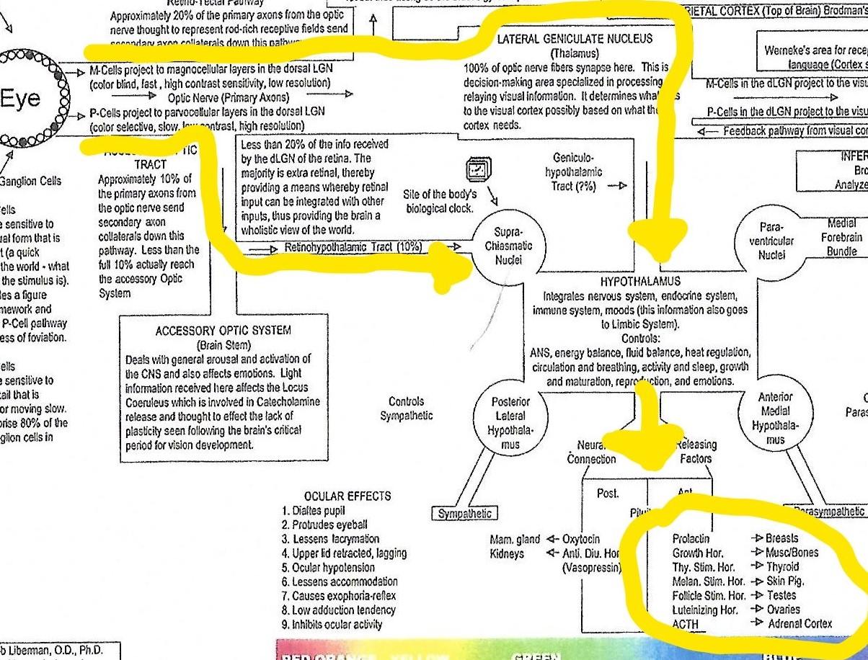


Slide 7
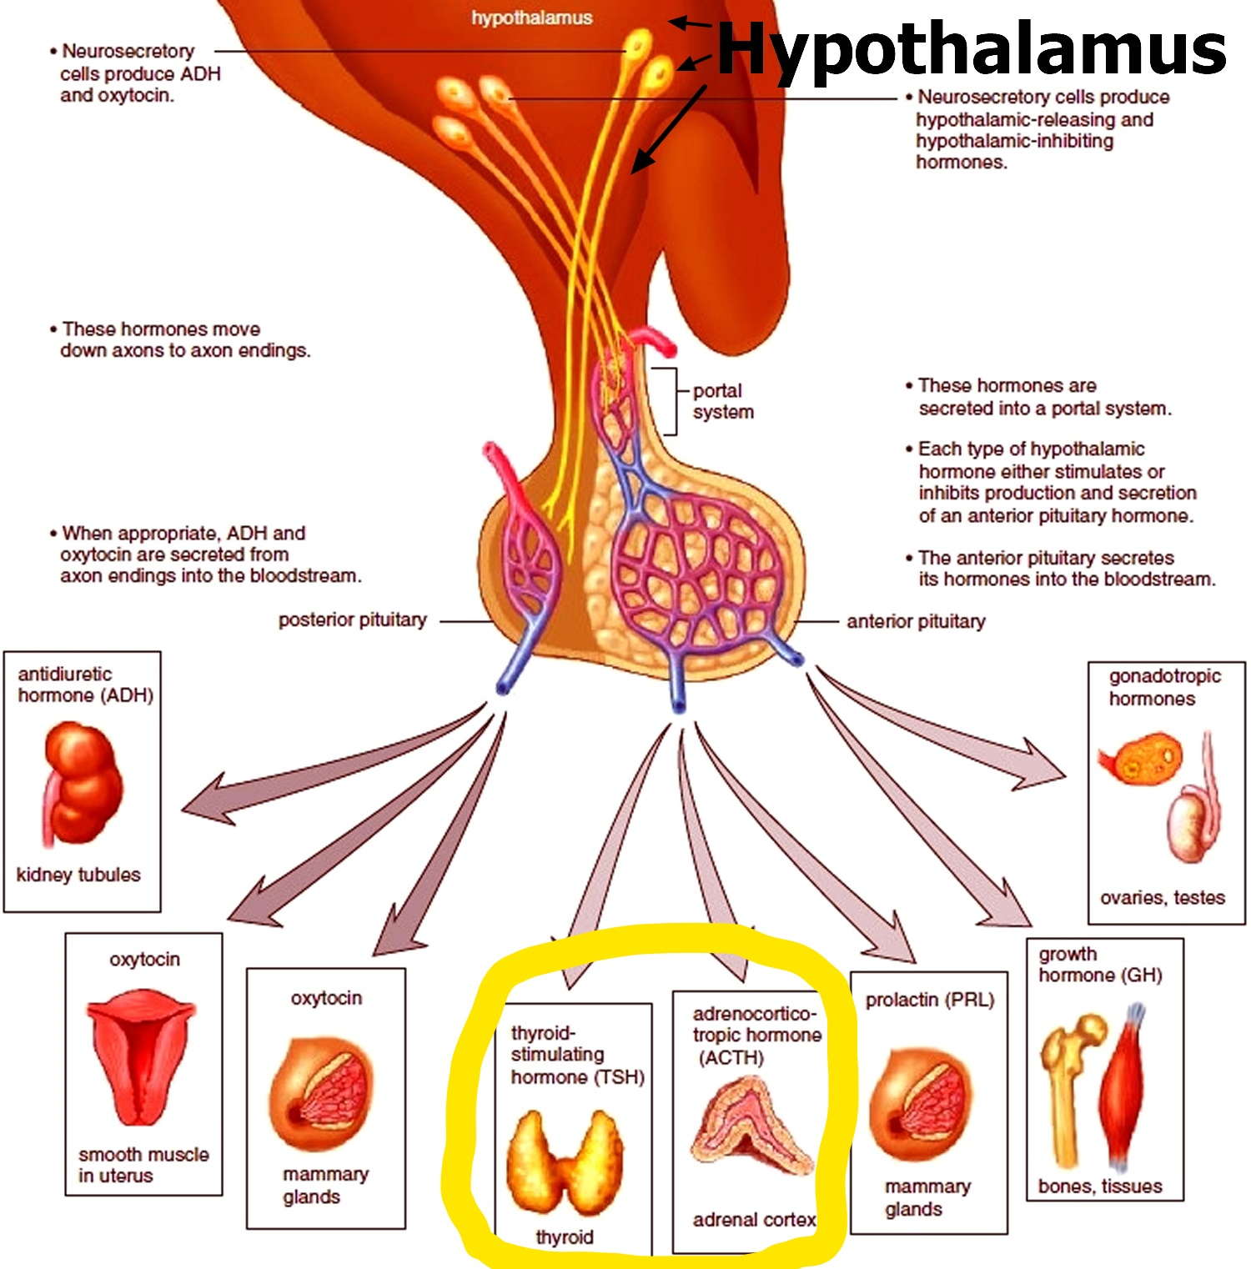

Slide 8
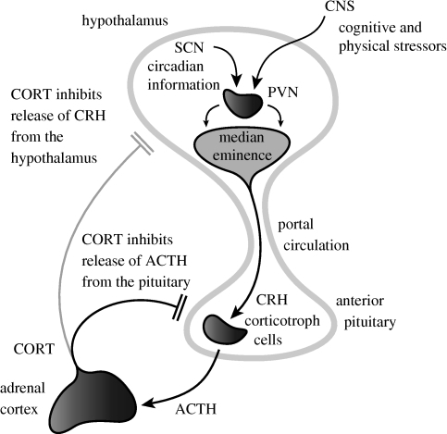
HPA Axis

Slide 9
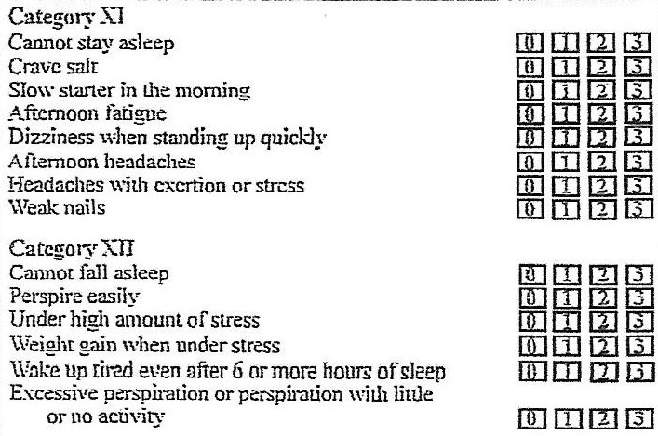
Hypo- and Hyperadrenal Symptoms

Slide 10
Common Markers in Adrenal Physiology
Blood chem markers(indirect)
Salivary index(direct)
Urine Testing (DUTCH) indirect

Slide 11
Common Markers in Adrenal Physiology
Blood chem markers(indirect)
Salivary index(direct)
Urine Testing (DUTCH) indirect

Slide 12
Blood Chemistry Markers for Adrenal Dysfunction
2 patterns
Hypoadrenia
Hyperadrenia

Slide 13
Hypoadrenia
LDH depressed 185-203 / 121-224
Sodium depressed 135-140 / 134-144
Potassium increased 4-4.5 / 3.5-5.2
Chlorides decreased 98-104 / 96-106
Fasting Blood Sugar depressed 85-99 / 65-99

Slide 14
Hyperadrenia
Fasting blood sugar elevated 85-99 / 65-99
Triglycerides elevated above 100 / +150
Sodium elevated 135-140 / 134-144
Potassium depressed 4-4.5 / 3.5-5.2
Chlorides elevated 98-104 / 96-106

Slide 15
Blood Sugar Markers
Relationship to adrenal physiology
FBS, A1C LDH Tryglycerides
Symptoms

Slide 16
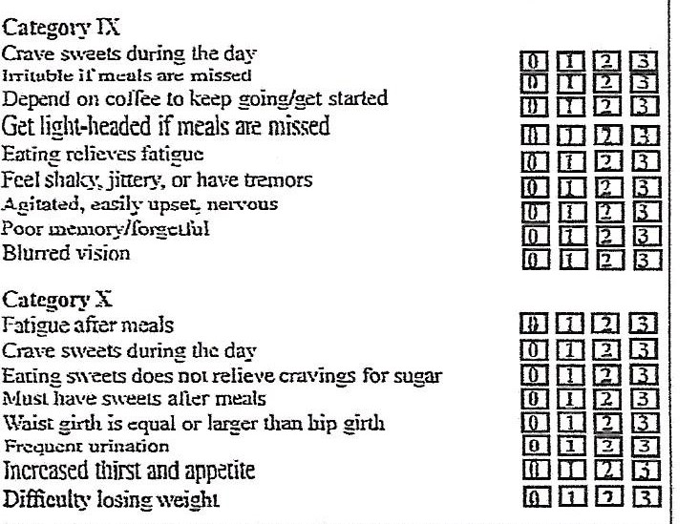
High and Low Blood Sugar Symptoms

Slide 17
Adrenal Salivary Index
Cortisol amount
Cortisol circadian rhythm
Cortisol: DHEA ratio

Slide 18
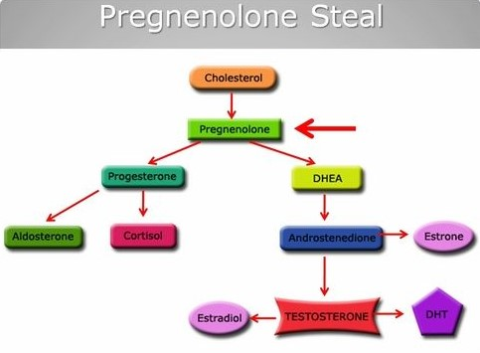

Slide 19
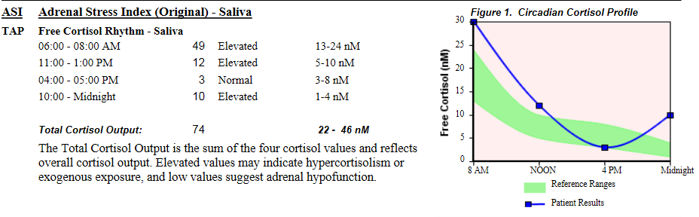
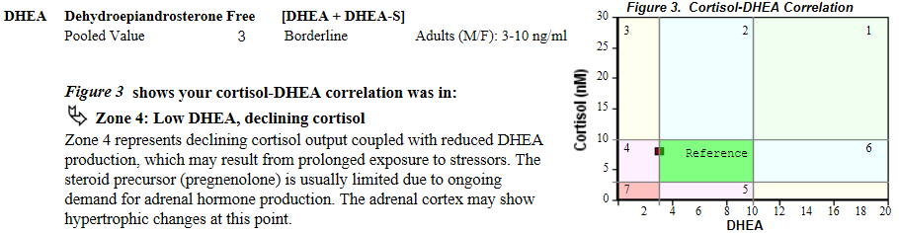
Hyperadrenia : Elevated Ratio/Altered Rhythm

Slide 20
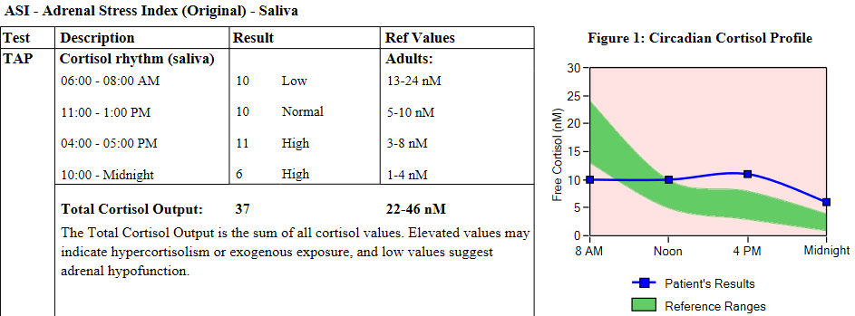
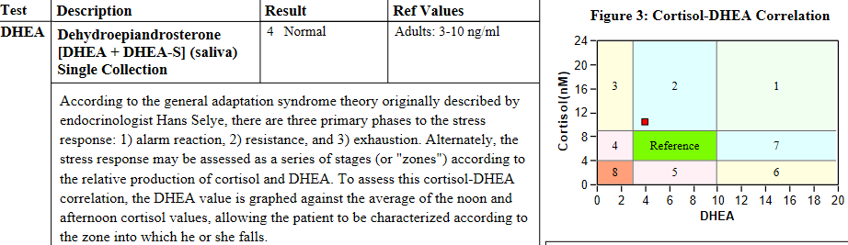
Altered Rhythm/Elevated Ratio

Slide 21
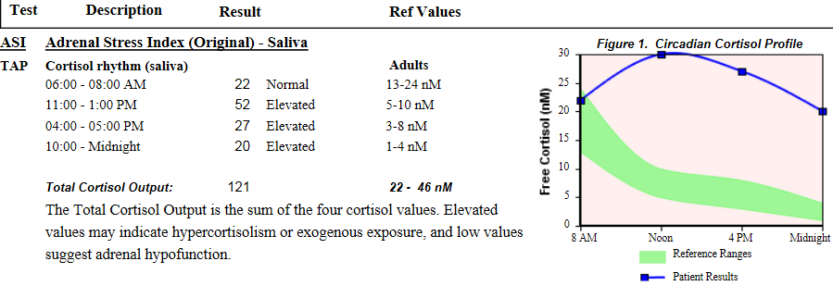
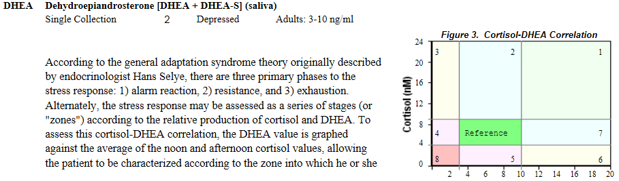
Elevated Cortisol and Ratio, Abnormal Rhythm

Slide 22
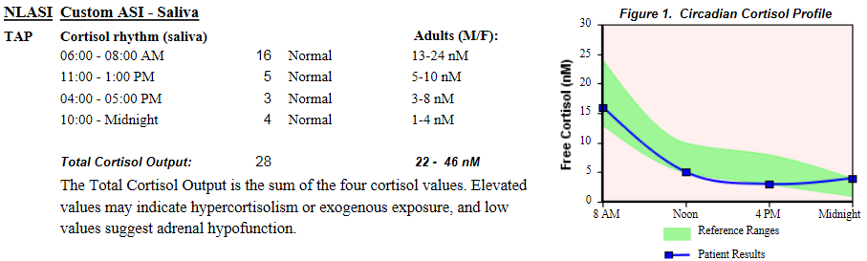
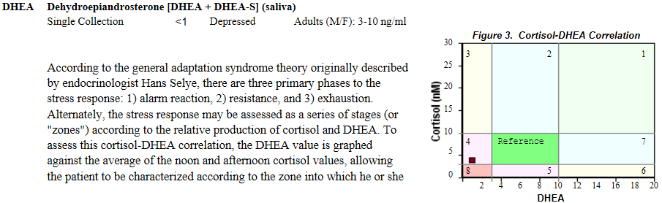
Normal Cortisol:Elevated Ratio

Slide 23
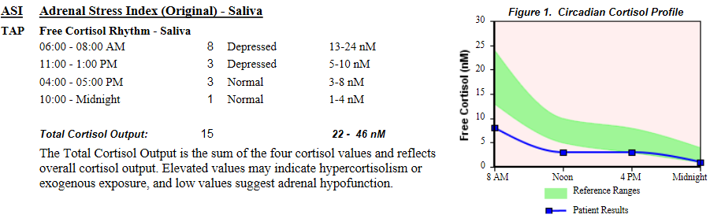
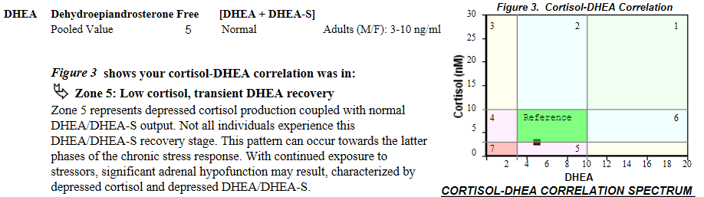
Low Cortisol:Normal DHEA
cccccccccccccccccccccccccccccccccc

Slide 24
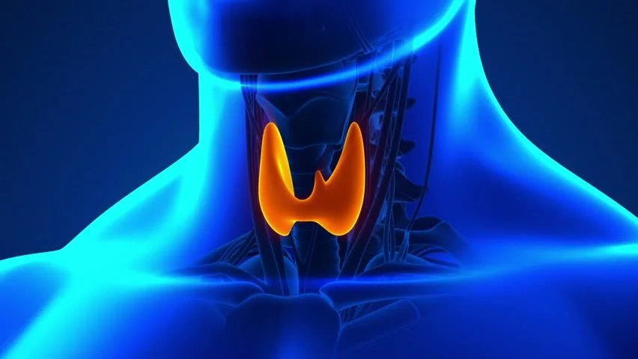

Slide 25
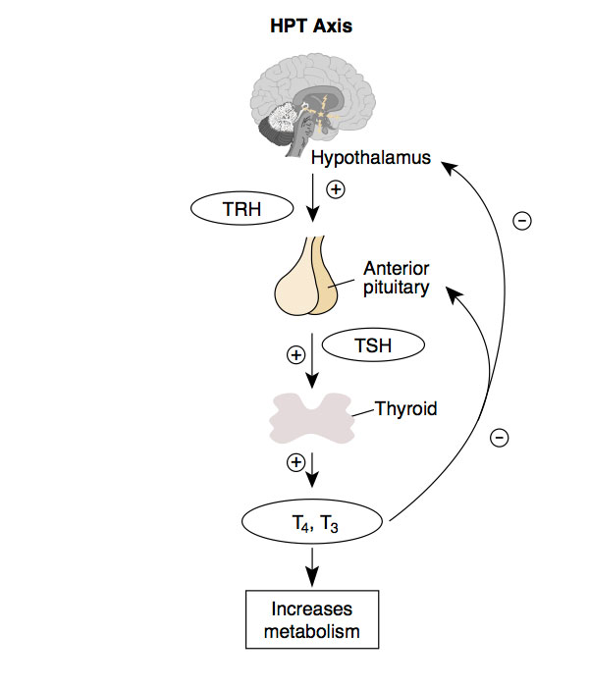

Slide 26
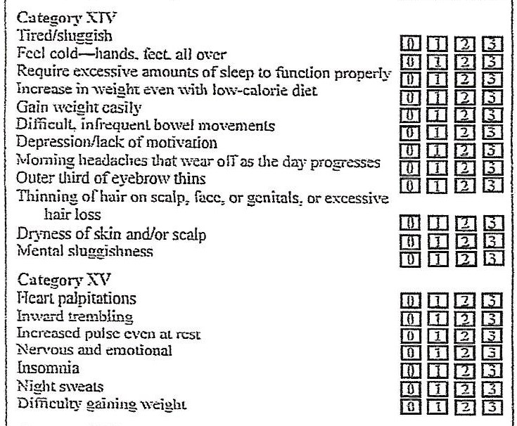
Hypo- and Hyperthyroid Symptoms

Slide 27
Serum Thyroid Markers
TSH, T4, T3 T3U, Ft4 Ft3 ,RT3, Thyroid antibodies
Significance of these markers: Thyroid Physiology
Patterns of Thyroid Physiology dysfunction

Slide 28
Thyroid Functional and Lab Ranges
Functional Range Lab Range
TSH 1.8-3.00 .45-4.5
T4 6-12 4.5-12
T3 100-180 71-180
Ft4 1.00-1.50 .82-1.77
fT3 3.0-4.0 2.0-4.4
T3U 28-38 24-39
Rt3 9.2-24.10 9.2-24.10
TPO Ab 0-34 0-34
ATG Ab 0-.9 0-.9

Slide 29
Thyroid Functional and Lab Ranges
Functional Range Lab Range
TSH 1.8-3.00 .45-4.5
T4 6-12 4.5-12
T3 100-180 71-180
Ft4 1.00-1.50 .82-1.77
fT3 3.0-4.0 2.0-4.4
T3U 28-38 24-39
Rt3 9.2-24.10 9.2-24.10
TPO Ab 0-34 0-34
ATG Ab 0-.9 0-.9

Slide 30
4 Common Patterns of Thyroid Dysfunction
Primary Hypothyroidism
Pituitary Suppression
Thyroid Underconversion
Autoimmune Thyroid

Slide 31
Primary Hypothyroidism
Elevated TSH
Depressed T4
Elevated cholesterol

Slide 32
Pituitary Suppression
Low T4 - below 6
Low TSH - below 1.8

Slide 33
Thyroid Underconversion
Down regulation 5’ deiodinase
Normal T4 range - 6-12
Depressed T3 - below 100

Slide 34
Autoimmune Thyroid
Most common Thyroid disorder in America 80-90%!
Often ignored in the medical/insurance model
Often ignored in the alternative medicine model
Elevated TPO and ATG antibodies

Slide 35
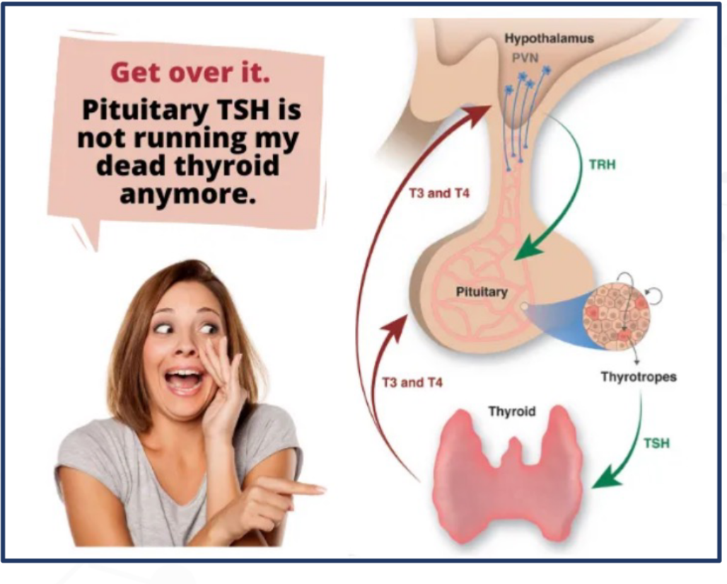

Slide 36
Which Thyroid Pattern Is This?
TSH 1.4
TT4 5.8
TT3 93

Slide 37
Which Thyroid Pattern Is This?
TSH 1.4
TT4 5.8
TT3 93
Pituitary Suppression

Slide 38
Which Thyroid Pattern Is This?
TSH 2.2
TT4 7.8
TT3 76
Ft4 1.25
Ft3 2.2

Slide 39
Which Thyroid Pattern Is This?
TSH 2.2
TT4 7.8
TT3 76
Ft4 1.25
Ft3 2.2
Thyroid Underconversion

Slide 40
Which Thyroid Pattern Is This?
TSH 5.8
T4 6.0
T3 93
Ft4 1.2
Ft3 3.0
TPO AB 24
ATG AB .7

Slide 41
Which Thyroid Pattern Is This?
TSH 5.8
T4 6.0
T3 93
Ft4 1.2
Ft3 3.0
TPO AB 24
ATG AB .7
Primary Hypothyroidism

Slide 42
Which Thyroid Pattern Is This?
TSH 5.2
TT4 5.8
T3 82
TPO Ab 128
ATG Ab 2.1

Slide 43
Which Thyroid Pattern Is This?
TSH 5.2
TT4 5.8
T3 82
TPO Ab 128
ATG Ab 2.1
Hashimoto’s

Slide 44
Conclusions
Look at functional (healthy) blood chem ranges
Adrenal dysfunction is dependent on cortisol amount, rhythm and ratio
Most thyroid dysfunction is autoimmune
Syntonic retinal input to the hypothalamus and endocrine system is profound.

Slide 45

Thank you for your interest in my presentation.
Don’t let labs confuse you. If you have further questions please email me at info@EyeBrainConnection.com

