Slide 1
The Syntonic Field Functional/Kinetic Mary Wong VanHoy, O.D., FCOVD, FCSO
College of Syntonic Optometry
June 1-2, 2022

Slide 2
What Is Functional Visual Field Measurement?
Definition: That area which may be seen without eye movement
A subjective examination of the sensory pathways

Slide 3
What Functional Visual Fields Are Not
Not for detecting pathology
Not for indicating the correct color frequencies

Slide 4
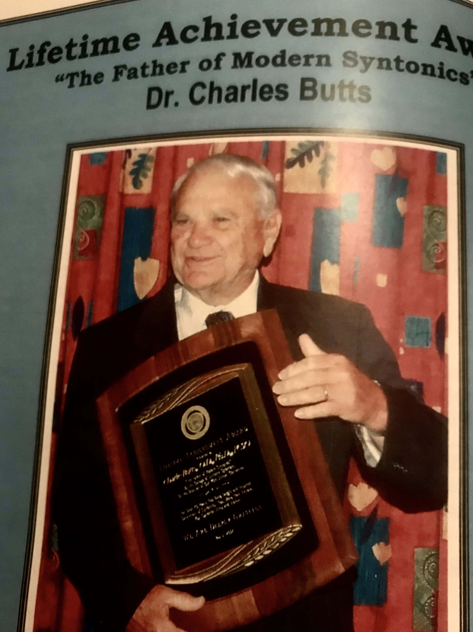
Why Functional Visual Fields
To answer the question, is our vision therapy working
To allow us to consider if the wrong frequency may be in use or the frequency may not be strong enough
Charlie Butts, OD, Dean Emeritus of CSO

Slide 5
Why Functional Visual Charting in Syntonic Optometry?
Discovering and demonstrating functional vision deficits
Because
If it’s VISUAL, it’s OPTOMETRIC!
Samuel Pesner, O.D., FCSO

Slide 6
The Kinetic,Functional Field Why Do It?
What is so unique and valuable about this field?
Why can it be used to monitor any therapies?

Slide 7
Often Grassroots Movements From Parents Motivate Us To Look Into Syntonics
8 y.o. (History: amblyopia - wears contact in right eye - diagnosed at age 6 - patched for year, ophthalmologist said nothing more to do). After light therapy, improvements in penmanship, less fidgeting and complaining of headaches during schoolwork. Also improved motor skills with catching balls, etc. Optometrist remarks noticeable improvement not only in field of vision, but also was able to make out two letters one step better in acuity. Definitely opened up field of vision. Very encouraging!

Slide 8
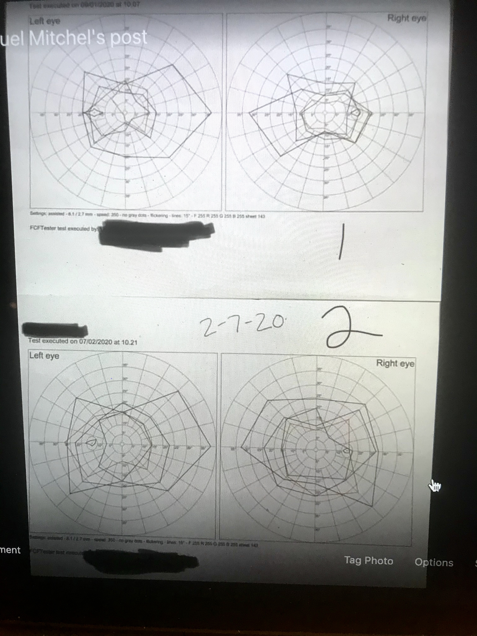
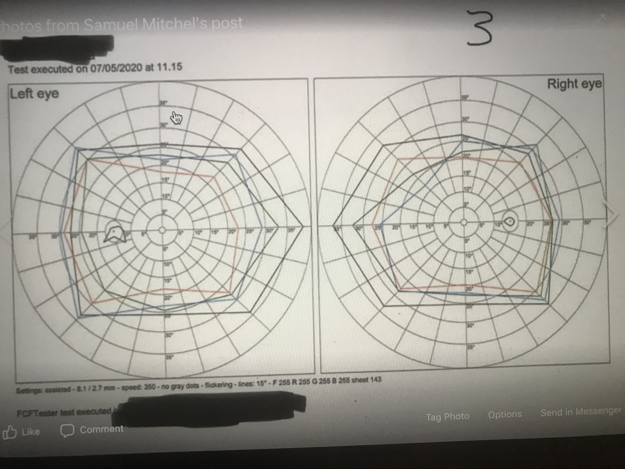
Parent Even Shared the Before and After Funtional Visual Fields

Slide 9
The Kinetic,Functional Field Why Do It?
It is an extremely sensitive field measurement
of visual performance and efficiency.
A compressed field affects such areas as:
Pursuit and Saccadic fixations
Reading speed and processing
Handwriting
Sports performance
Spatial perception
Behavior

Slide 10
The Kinetic, Functional Field Why do it?
Highly integrated with Autonomic Nervous System balance and function
Is a measure of capacity of the brain to process visual information and then project the image accurately into space
Is an assessment of how much space one is able to process and interact with at any one time affecting spatial judgments

Slide 11
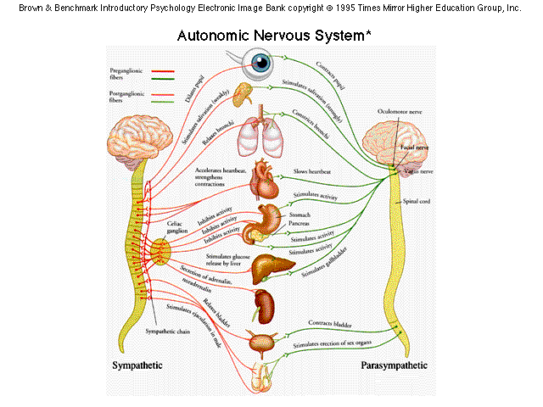
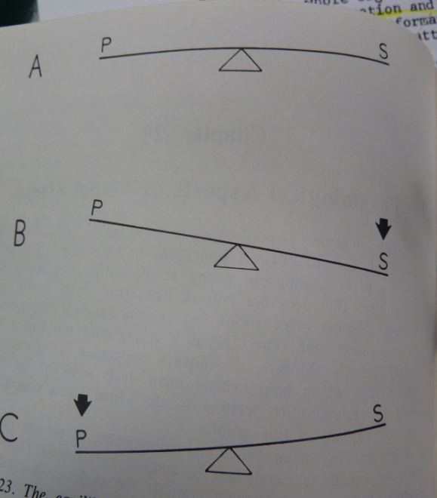
Autonomic Nervous System Spitler’s Syntony

Slide 12
ANS Spitler’s Syntony
Balance in Change
Harmonious
Neural Flexibility
Its vitality and tone determines the efficiency and quality of our ability to live
It is the underlying basis for accurate Projection

Slide 13
The Kinetic, Functional Field Why do it?
Opening a field is the key to overall wellness and accurate integration with the world and people around us
It is the most important measurement you will do as a clinician

Slide 14
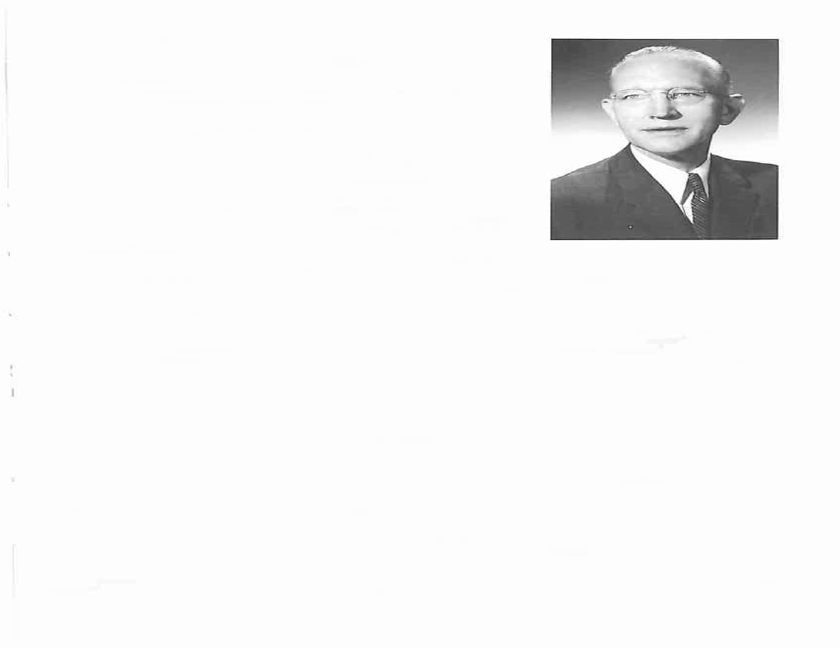
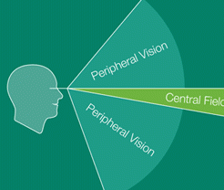
Vision as a process of Projection Skeffington—The Emergent
It is a projection into and interaction with the world around us
It includes both Input and Output as an ongoing process
This interpretation is on ALL levels of perception that includes integration of movement through Visual, Cortical, and Vestibular processes
“The ”What to do” is compounded out of the experiences of ALL of the inputs of the WHOLE body…and organism”
“Stresses bring constriction in the movement patterns. The constriction IS the visual problem.”

Slide 15
Vision as a Process of Projection Skeffington—The Emergent
Vision is an Emergent
It is projection
It is our belief that this is what we are measuring with the Campimetric field
”The whole cookie” Abe Shapiro

Slide 16
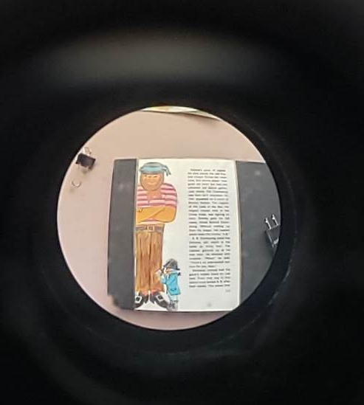

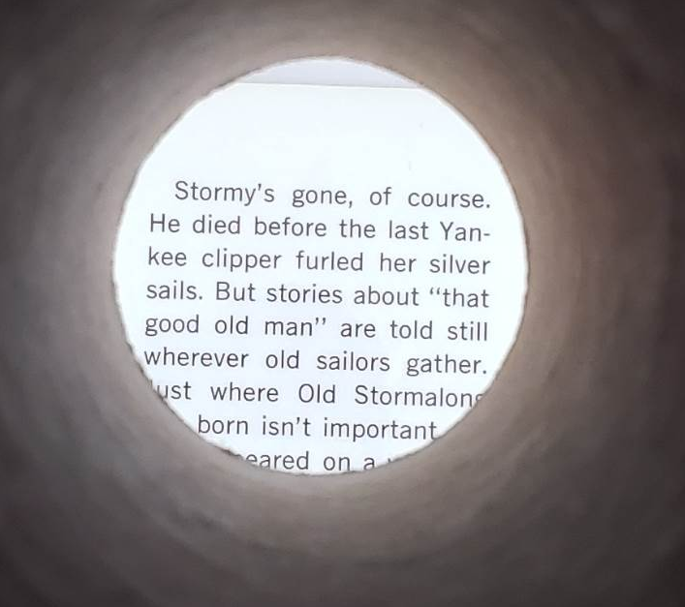
Possible Patient Perception With Visual Field Constrictions
Compression
Tunneling

Slide 17
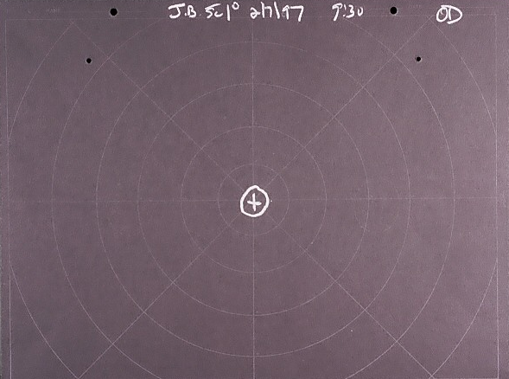
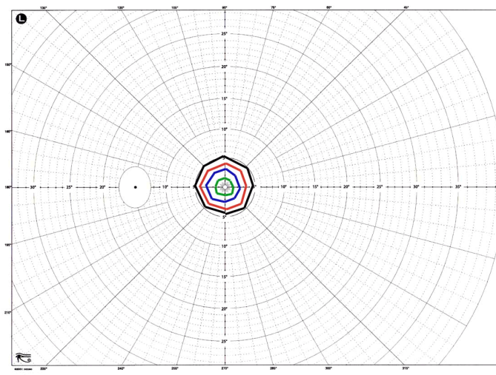
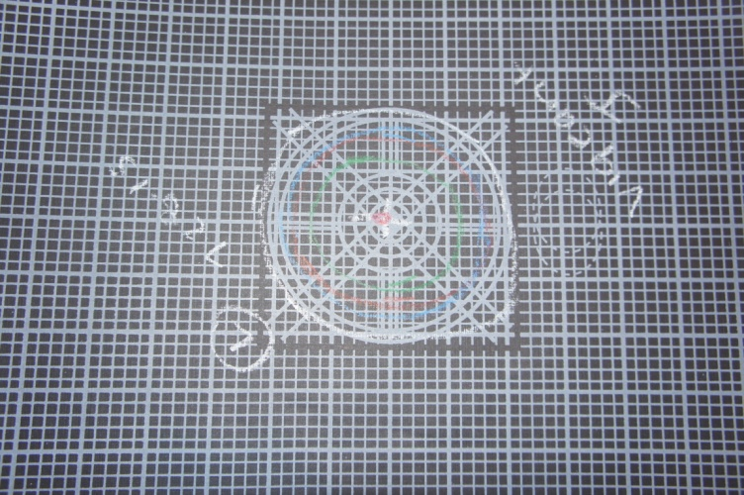
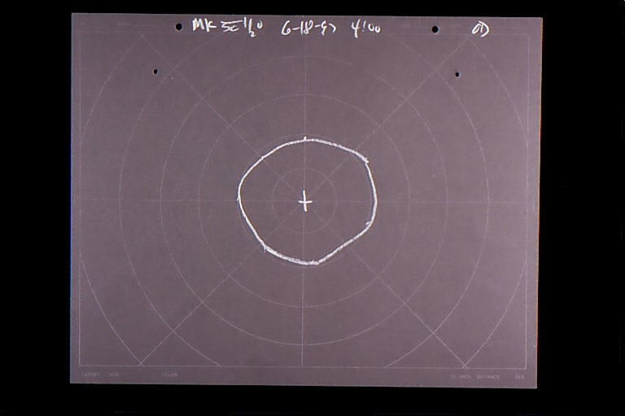
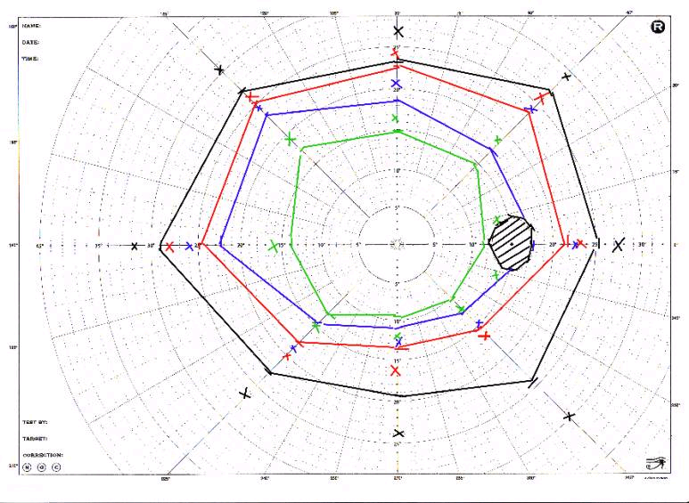
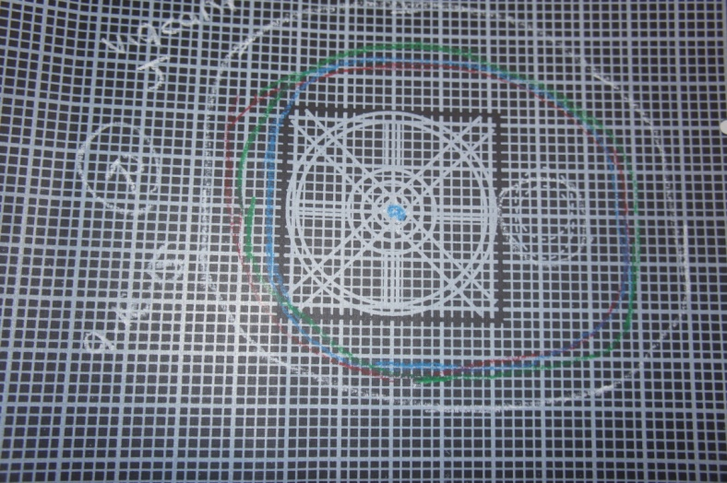
The Kinetic Visual Field The Abnormal Visual Field

Slide 18
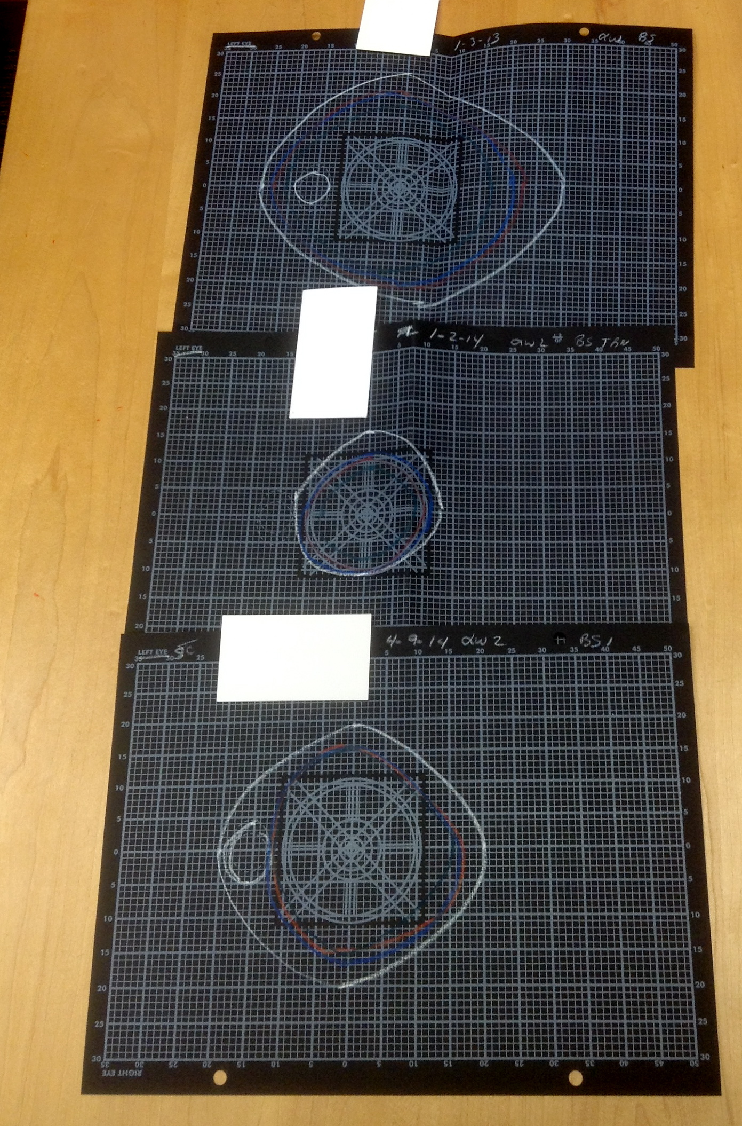
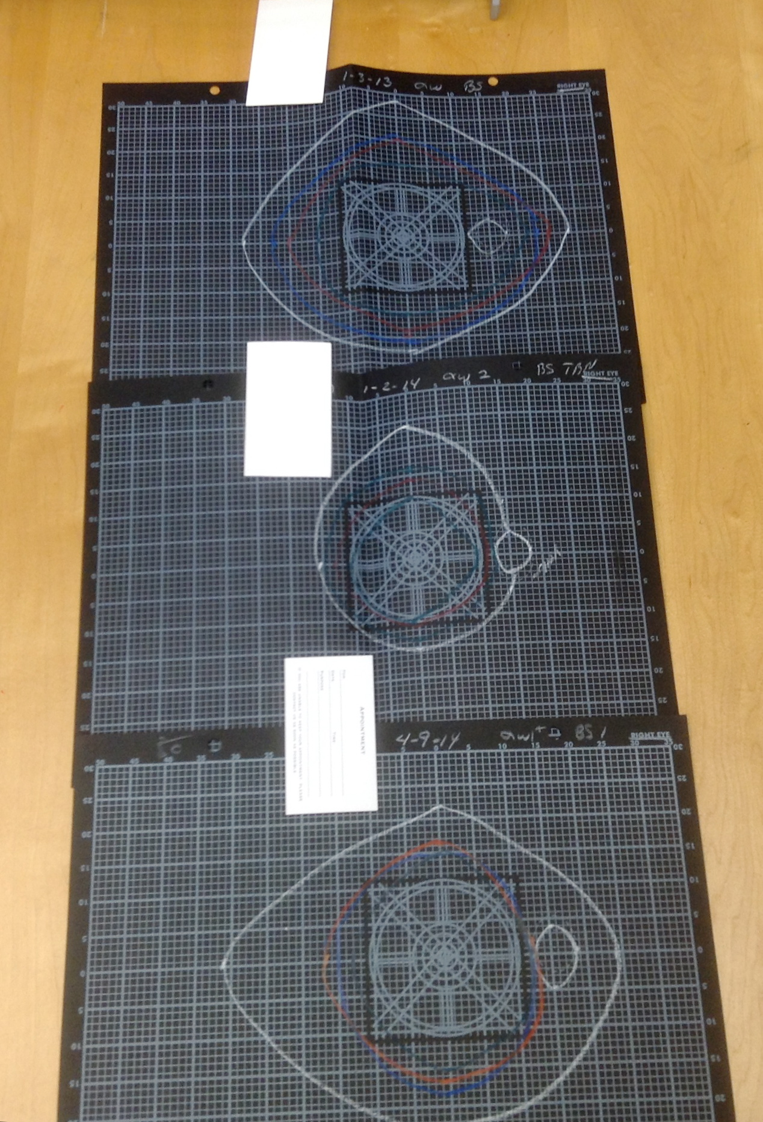
Example of Visual Fields Before and After Concussion Then After Syntonics

Slide 19
The Kinetic, Functional Field
Measurement

Slide 20
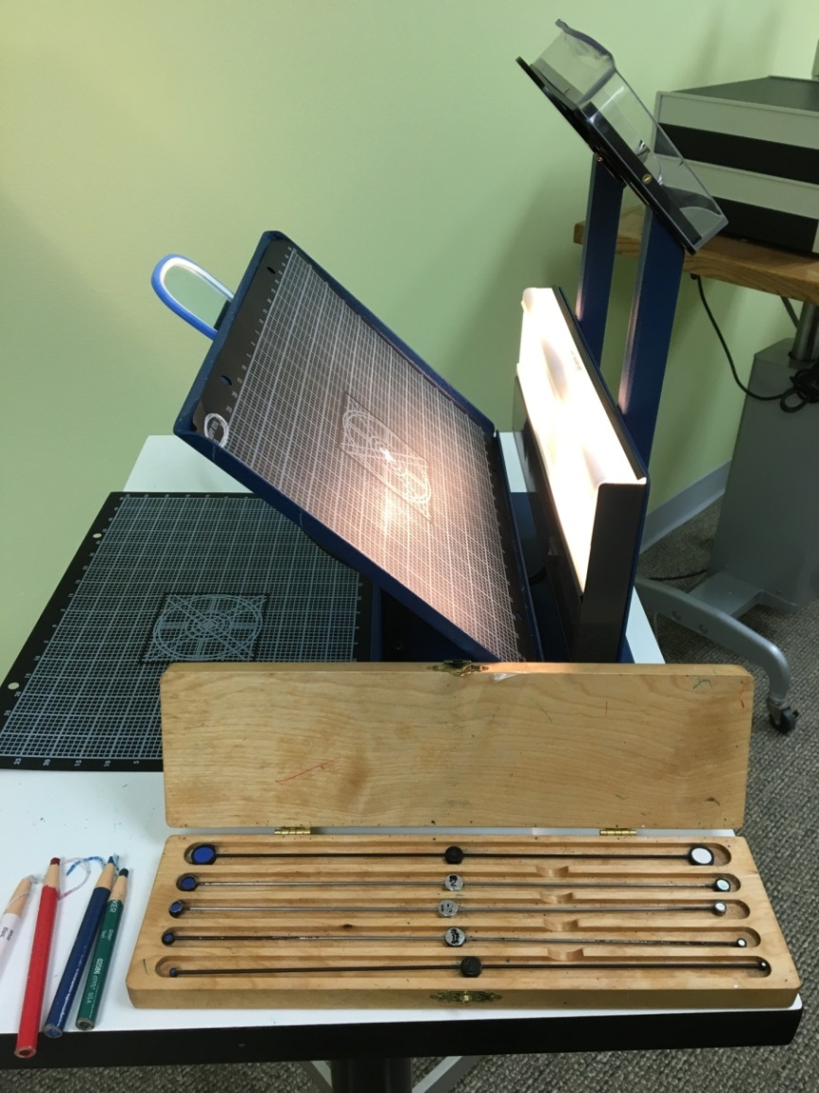
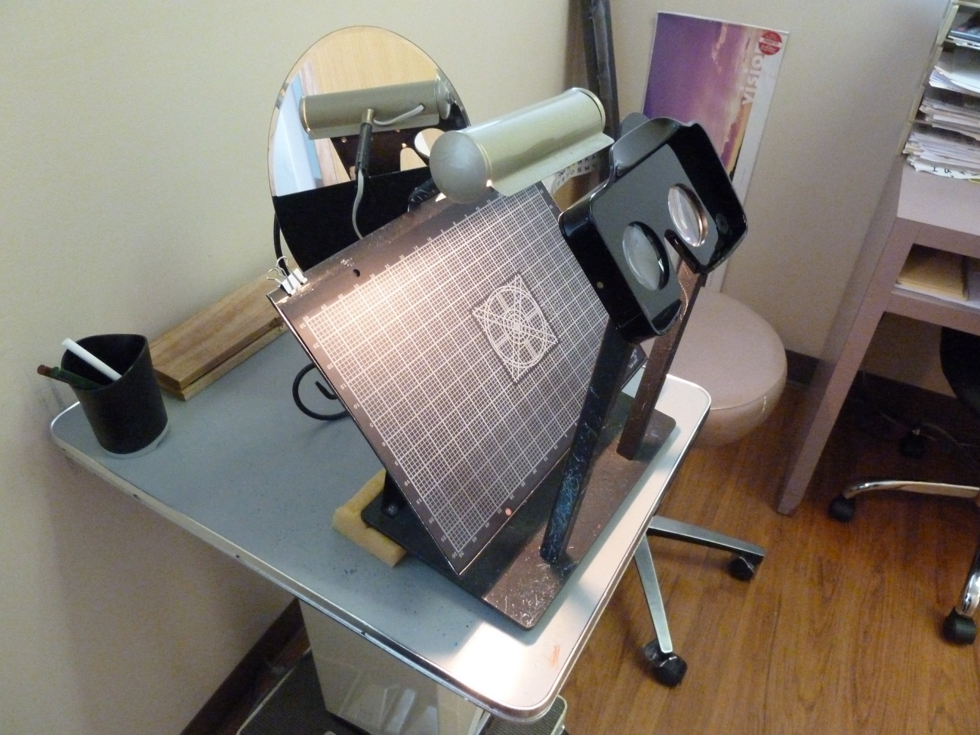
The Kinetic Visual Field Instruments The C & J Stereo Campimeter
C & J Stereo Campimeter

Slide 21
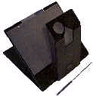
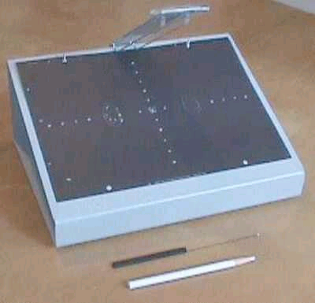
Additional Campimeter Options
An earlier model from Florida
(no longer available)
Foldable Unit from Hummingbird Hues

Slide 22
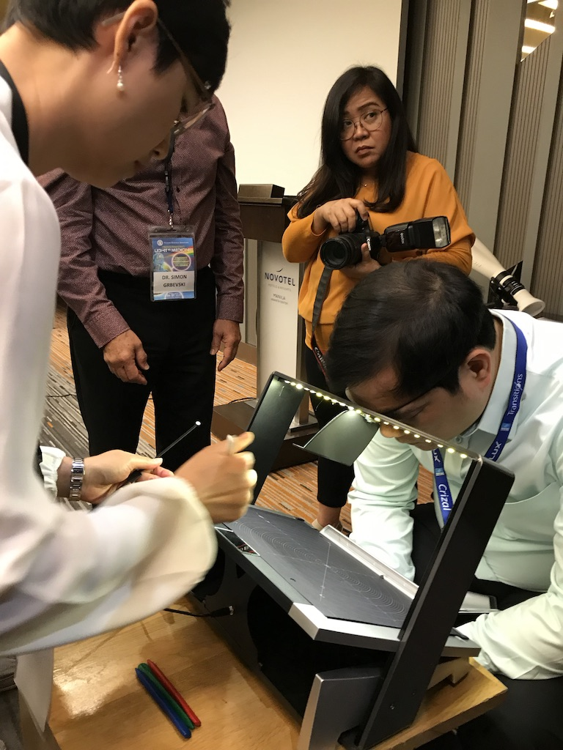
Dr. Simon Grbevski’s Versatile Fields Unit

Slide 23
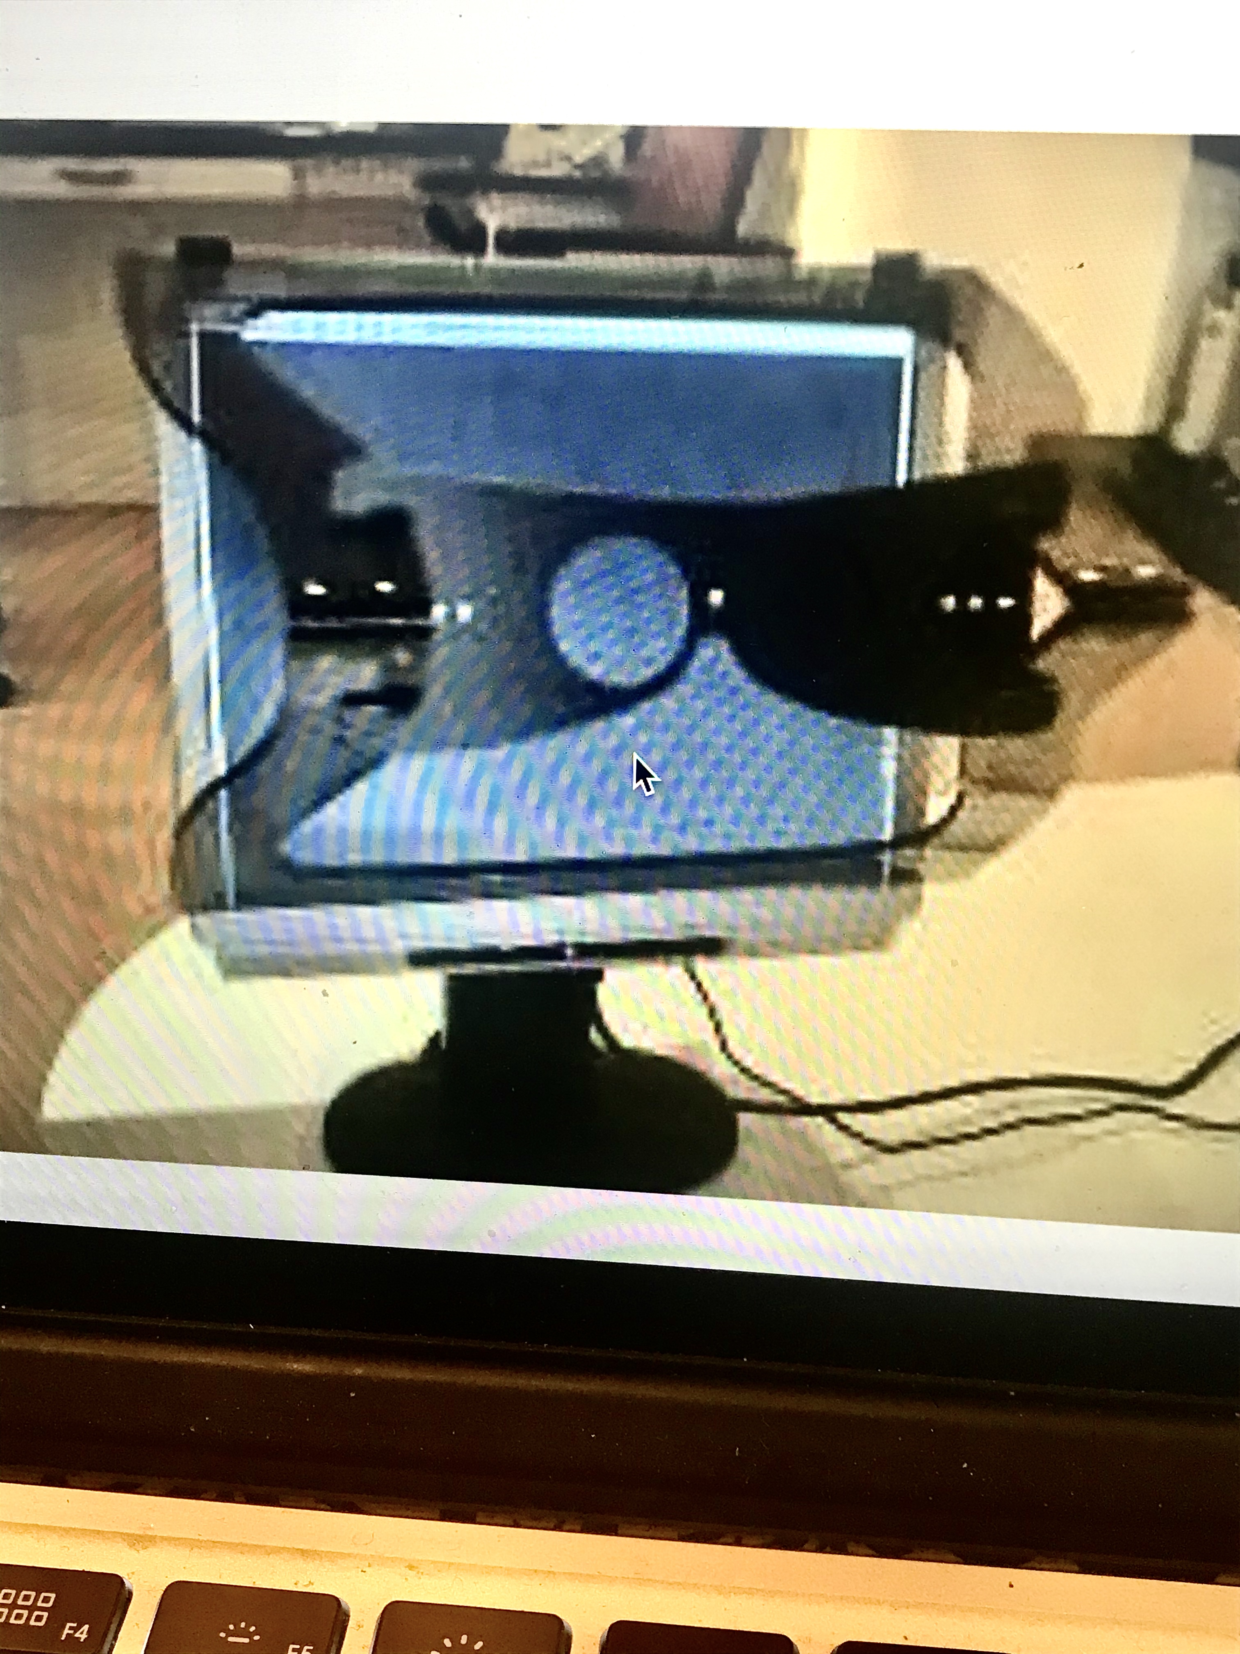
Automated kinetic field charter
Made by Rainbow-Flash of Belgium
Distributed by Bernell Corporation
Utilizes a Windows based computer screen
Offers helpful features for printing out results and controlling the lighting, central fixation target and repeat testing for any suspected errors

Slide 24
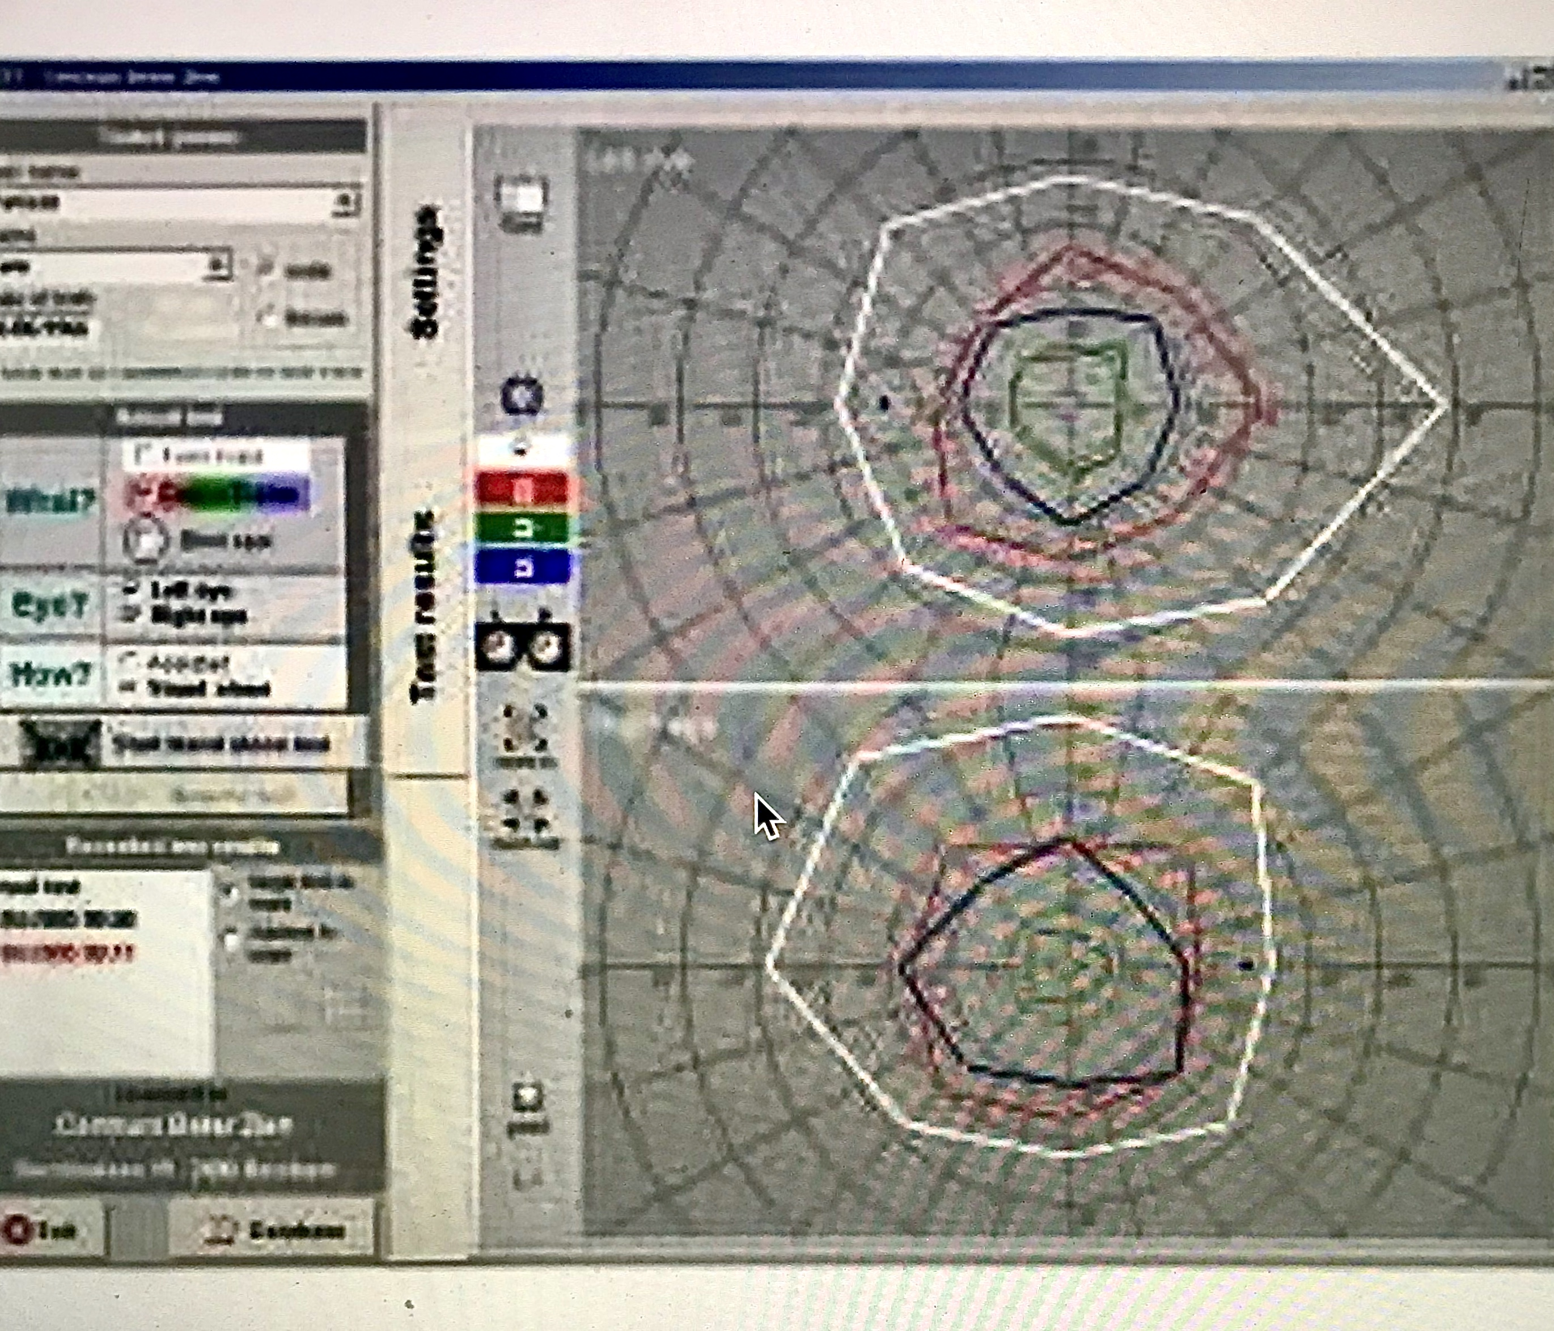
Example of Field Measurements with Automated Unit
Data can be stored and comparisons of earlier measurements available
(May ask Bernell at the break for more details)

Slide 25
The Kinetic Visual Field Measurement
Motion Field (1degree – 2.0 degree target)
Four targets (non-seeing to seeing) (1 degree - 1.5 degree)
White
Green
Red
Blue
Blind Spot (non-seeing to seeing) 0.5 degree – 1.0 degree white target)

Slide 26
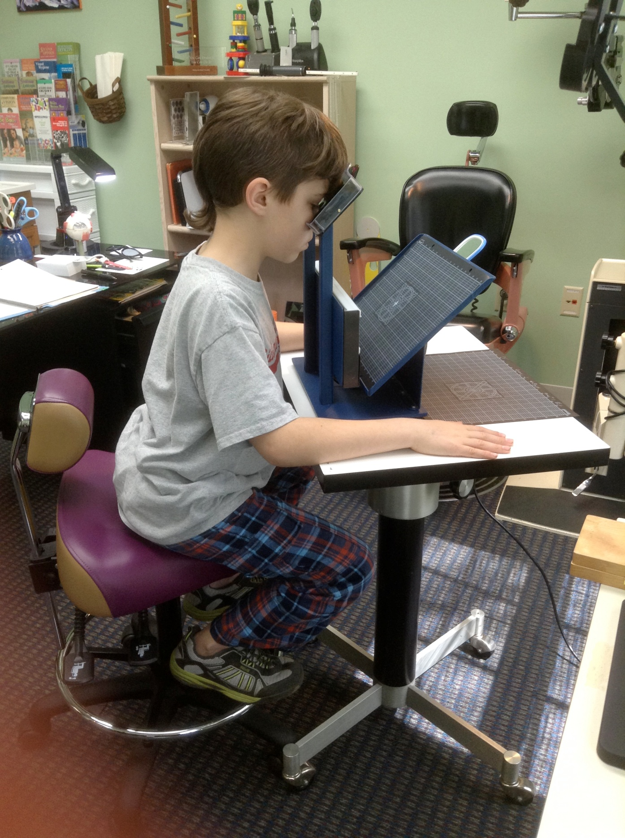
The Kinetic Visual Field Measurement
Make sure feet are supported
Forehead gently against head rest
Table at comfortable height
Hands along sides of table
Shoulders relaxed
Left eye occluded
A mirror taped to top of chart holder to observe patient’s fixation
If possible, lower intensity of lamp

Slide 27
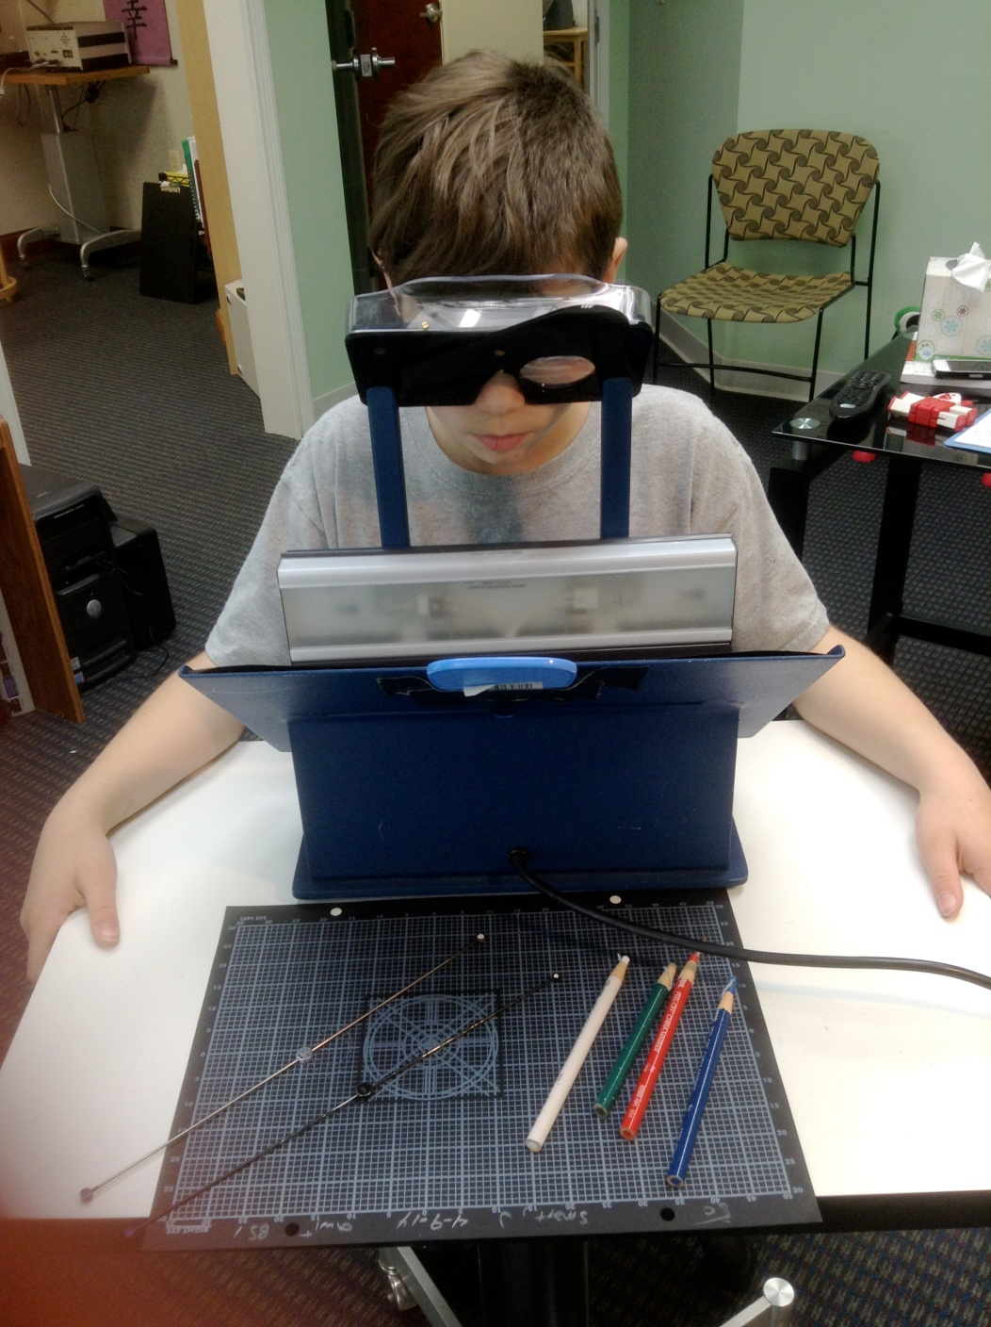
The Kinetic Visual Field Measurement
Label on Chart
Name
Examiner
Date & Time of Day
Which eye
With or without Rx
May draw on same chart
Some prefer to document on separate chart not seen by patient
Alpha Omega Pupil
Brock String Measurement
Clinical Pearl: consistency and same person if possible for re-testing

Slide 28
The Kinetic Visual Field Measurement
Mark Fixation spot. White cross in center of chart
For Children – Face, Picture, etc
Key – Monitor fixation mirror – top or behind chart
Measure peripheral motion field with 5mm (2⁰) white dot
Measure White (1.5 degree), blind spot (1.0 degree) and then colors with 1.5 degree target.
Measure overall field at least 8 points. Blind spot 8 points.

Slide 29

The Kinetic Visual Field Measurement
Educate Patient Prior to Test:
General Instructions
Always give a trial especially the colors
Motion
White – first aware of white target.
Blind Spot
Colors

Slide 30
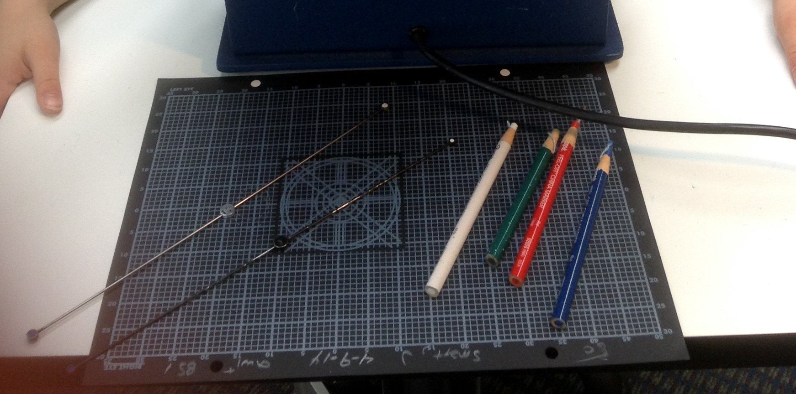
Administering the Field Measurements
Make a white cross in center of chart as fixation point
Ensure good patient fixation by observing patient’s eye in mirror at top of charter
Measure peripheral motion field with 5mm (2⁰) white dot
Measure white form field with 1.5 degree white target
Measure color fields with 3 mm(1.5⁰) green, red, then blue targets in this order
Measure from non-seeing to seeing
Measure 8 cardinal positions
Measure physiological blind spot using a 1degree white target going from non-seeing to seeing and ask when they first see the dot, do 8 cardinal positions. If using the 1.5 degree white target ask when they see the whole dot
Orient recording paper as patient’s view

Slide 31
Measure Central Color Fields
Repeat same procedure as measuring the white peripheral form field using a 1.5 degree color target except
Measure green, red, then blue fields in this order
Place a 1degree green target over the white cross in the center of the chart for patient’s fixation target and to allow the patient to better compare same color as fixation target without looking at target
Repeat measurements going from non-seeing to seeing
Try to use a consistent, steady speed of movement
Occasionally, wait a moment before starting the movement of the target so patient does not anticipate the target
Make measurement marks on the second sheet, not on the sheet the patient is looking at
Repeat with the red target and then with the blue target

Slide 32
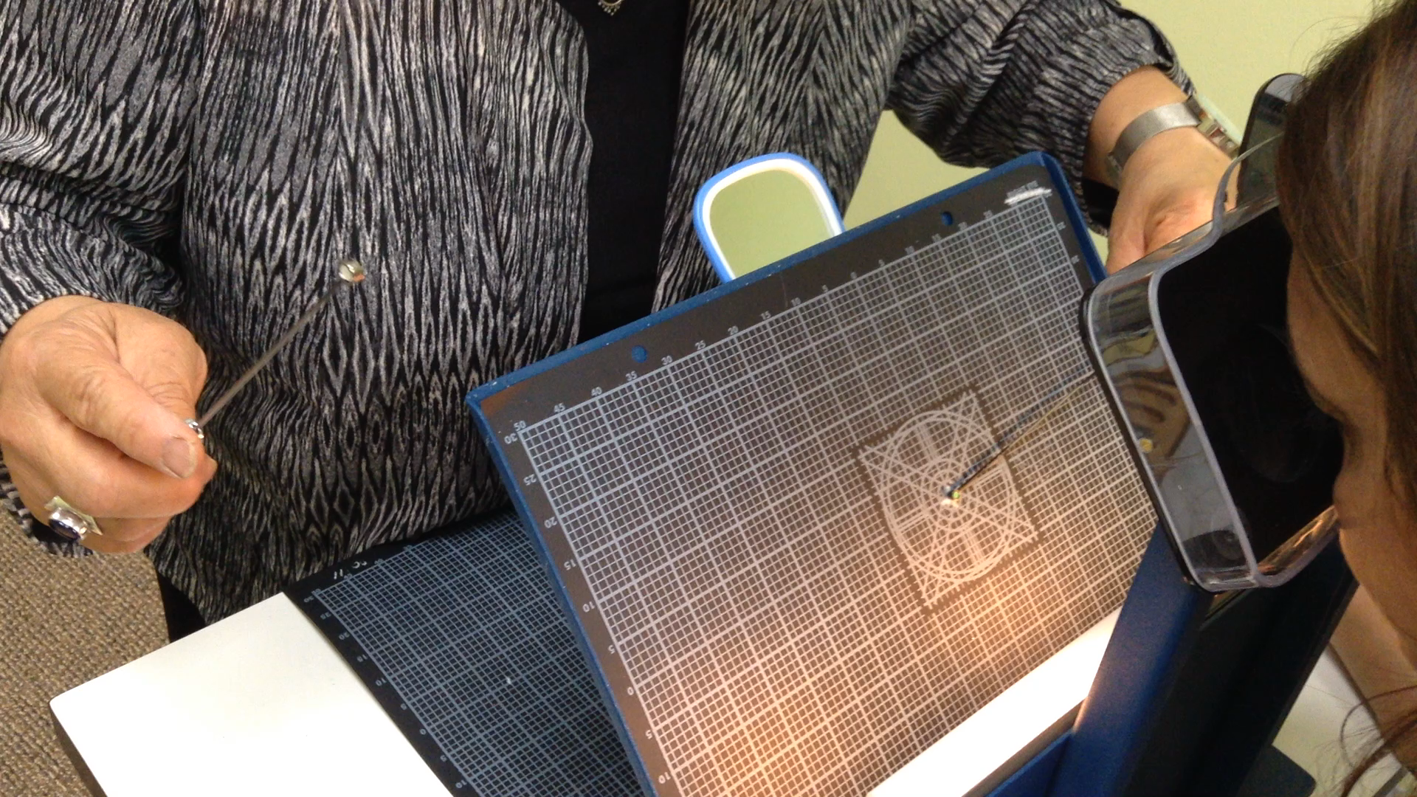
Administering the Central Color Fields

Slide 33
Checking for Scotomas
When checking for suspicious scotomas, move your target in small up and down motion
1. As you approach the cross from all directions, ask if the dot ever disappears (scotoma)
2. Ask if the dot ever looks double (fluid or detachment)
3. If inside 10⁰, use a 0.5⁰ target

Slide 34
Borish Clinical Refraction 3rd Edition
White (form) Blue Red Green
Norms for Visual Fields
Out: 100⁰ 75⁰ 41⁰ 30⁰
In: 60⁰ 38⁰ 23⁰ 18⁰
Up: 60⁰ 38⁰ 26⁰ 18⁰
Down: 80⁰ 46⁰ 29⁰ 24⁰

Slide 35
Norms for Visual Fields Samuel Pesner, OD (Peter & Hirschberg, 5 mm target @ 33 cm)
Blue Red Green
Out 65 40 30
In 39 25 19
Up 39 26 18
Down 38 30 25

Slide 36
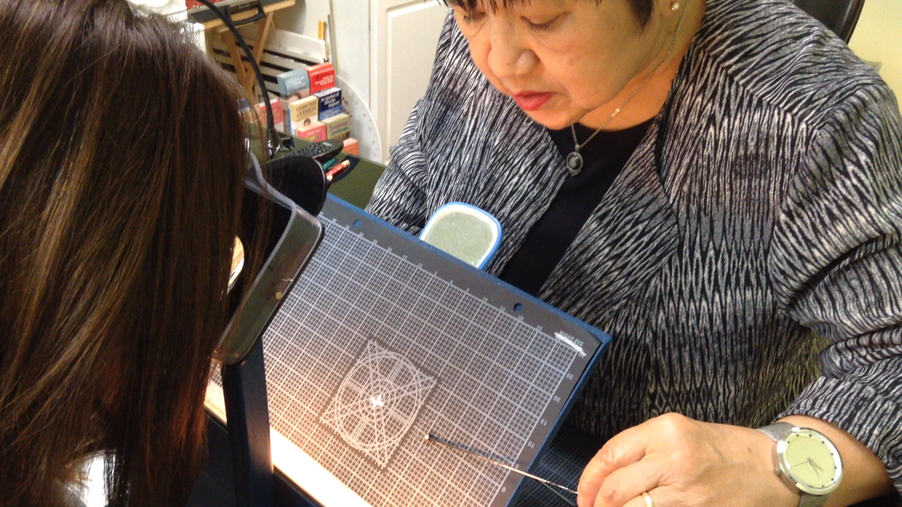
Plotting the Blind Spot

Slide 37
Norms for Physiological Blind Spot
25 mm vertically
17 mm horizontally
On campimetry chart (Charlie Butts)

Slide 38
Physiological Blind Spot
If fields are normal in size but blind spot is enlarged, results will not hold unless the blind spot is back to normal size
If twenty sessions have been given and blind spot and/or fields are improved but not entirely normal in size, discharge patient for four to six weeks and then re-measure fields
If fields remain unchanged or deteriorate, resume treatments and decide to continue with the same gentler frequency if the fields have not deteriorated or use a stronger frequency if deteriorated

Slide 39
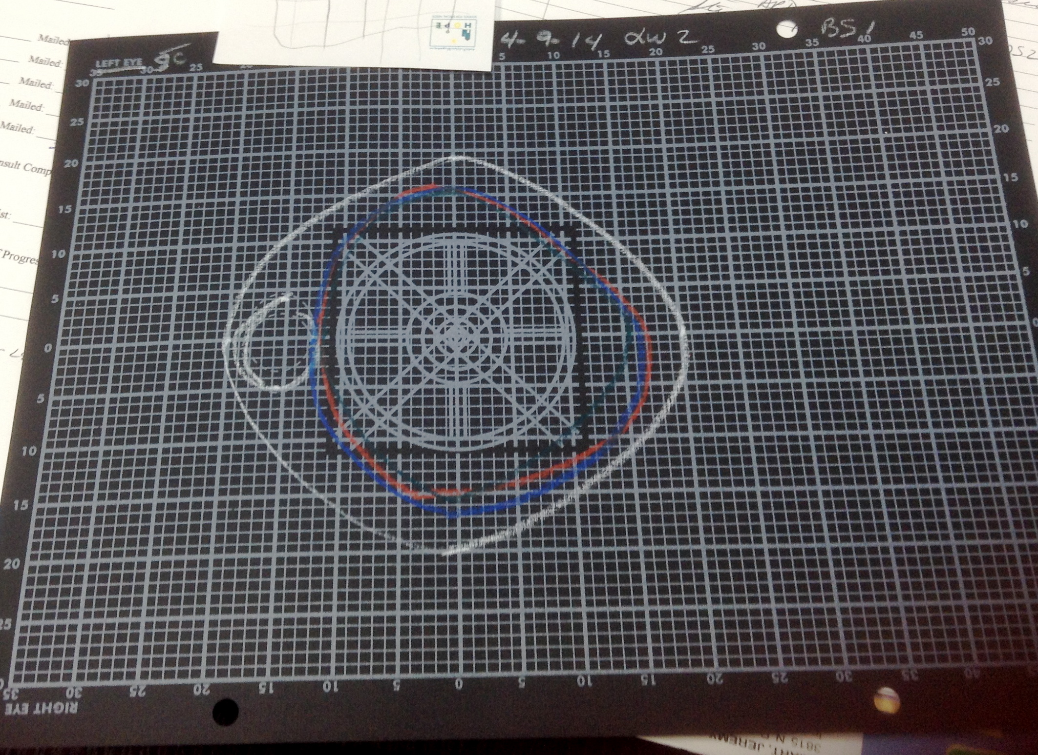
Example of Enlarged Blind Spot and Interlacing of Color Fields

Slide 40
The Kinetic Visual Field Interpretation
Color Fields
Test green, red, blue (smallest to largest)
There should be no interlacing or overlapping
When testing be aware of the patient noting the
fading of color or color coming on and off.

Slide 41
The Kinetic Visual Field Interpretation
Motion Field
The extreme periphery of the retina capable of receiving sensations of motion without recognition of contour [motion is first form of vision – R. Melillo]
Form Field - White
Recognition of contours of an object
extent is when the patient can retain the perception of white in a stationary position

Slide 42
The Kinetic Visual Field Interpretation
Color Fields
Test green, red, blue (smallest to largest)
There should be no interlacing or overlapping
When testing be aware of the patient noting the
fading of color or color coming on and off.

Slide 43
The Kinetic Visual Field Interpretation - Colors
Green:
An indicator of personal relationships, our immune systems, our lifestyles and chemical toxicity levels. It reveals our level of exhaustion. Focal infections, choroidal or retinal disease such as abscessed tooth, tonsillar infection, sinusitis, poisoning such as alcohol, drugs, paint
Red:
Represents the physical body, the major organs,,an indication of one’s physical and structural strength. Systemic chronic conditions, Diabetes, hypertension or increased white blood count causes constriction.
Blue:
Related to heart/circulation, Adrenals. Both physical and emotional, “broken heart.” A strong indicator of psychological stress. Can also be related to chronic respiratory and breathing issues

Slide 44
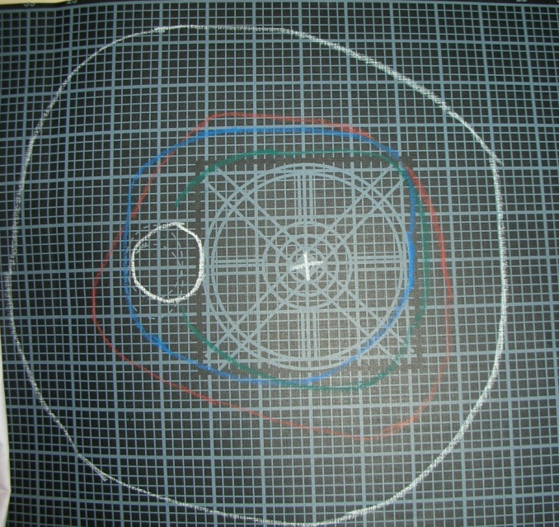
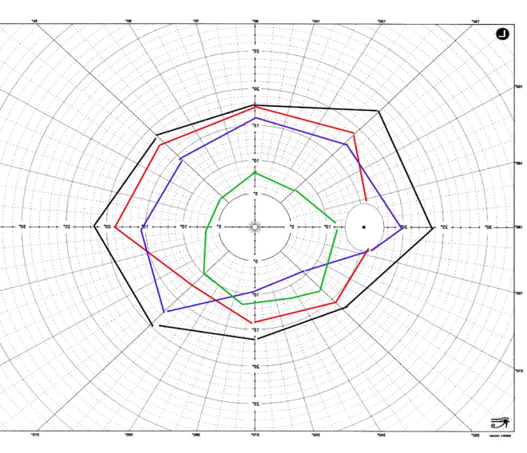
The Kinetic Visual Field Interpretation
Interlacing
Interlacing of the color fields: exogenous (outside the body) toxemias such as alcohol, drugs, tobacco, coffee, tea
Interlacing from endogenous (within the body) such as diabetes, kidney disease, glandular conditions may also cause color field constrictions and interlacing
Low Fusional Reserves
Lateral depressions, especially in the nasal field for red and blue only

Slide 45
Other Rules of Thumb
If fields are 10⁰ or less, prepare the patient before treatments that more than one series of treatments may be needed
The longer the condition has existed and/or the severity of the condition, the greater the probability for an extended period of treatments
When the condition is deeply embedded, not only the visual system but the physiological and emotional systems are usually also involved

Slide 46
When to check the visual fields
When patient complains of discomfort when refractive and muscular status does not warrant it—could be bodily, systemic toxicity
When fusional breaks or recoveries are abnormal with recovery low, could be some type of systemic condition
When heterophorias are constantly varying, suspect toxemia
If peripheral fields are not within normal limits, VT results are greatly reduced

Slide 47

Q & A

